Slide 1
Unit 4 Summary

Slide 2

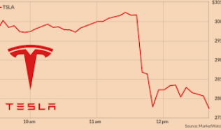

Financial Assets - Stocks and Bonds
Summary
Stocks = own a piece of the business.
Bonds – IOU. The owner of the bond will be paid back.
Depending on national laws, locals and foreigners are permitted to buy financial assets on international capital markets. Two common types of financial asset are stocks and bonds.
Debt based asset
Bonds
A ‘piece of paper’ which is an I.O.U. (I owe you) for the holder of the bond. They are paid back over a period of time which depends on the type of bond.
Selling a bond is really the same thing as borrowing money. Eg. If the US government sells bonds it is borrowing money from people that it will pay back in the future.
Commonly issued by governments eg. US Treasury Bonds to raise money for the government or conduct Monetary Policy (OMO)
Eg. You buy a bond from the US government. The piece of paper/contract that you hold says that the government must pay you back.
Stocks
Represents ownership / part ownership of a company
  Eg. If there are 1000 shares and you buy 100 shares, you own 10% of the company
If a company is profitable, it will often pay out dividends (a share of profits) to the owners
Equity/ownership based asset

Slide 3
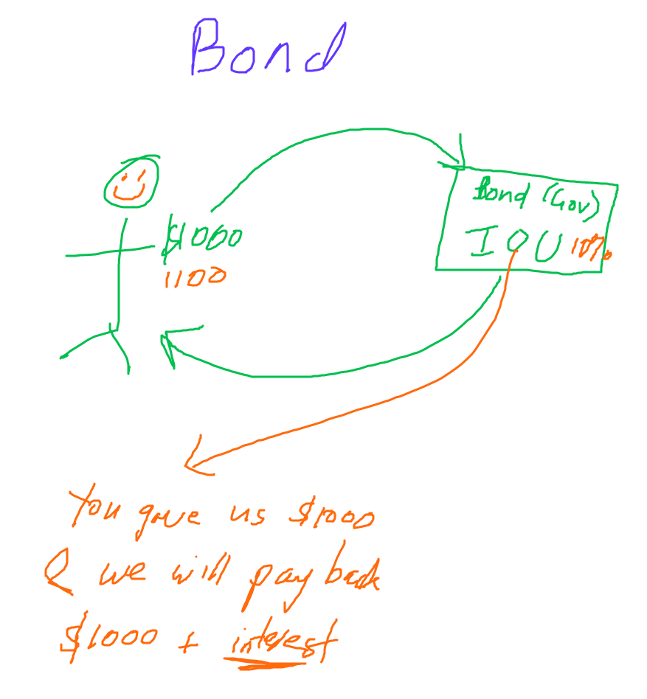
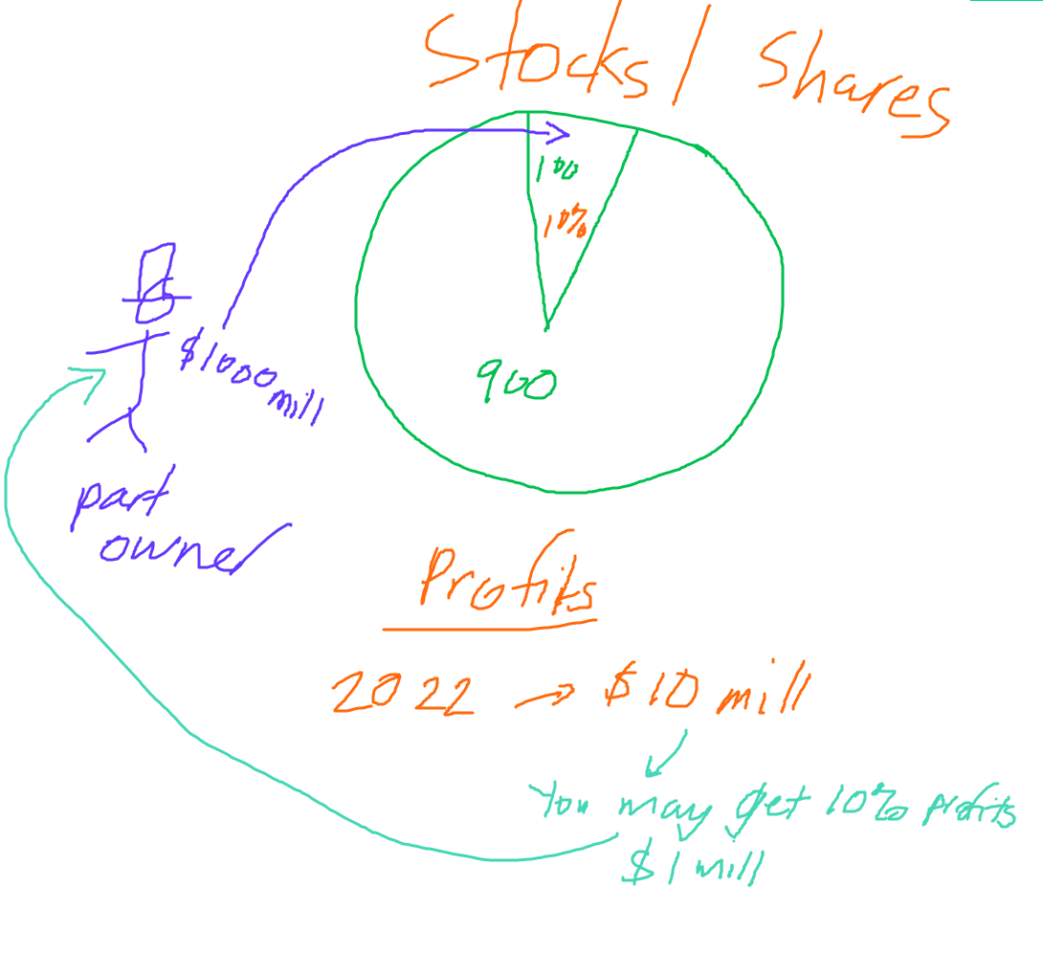

Slide 4





Bonds – more detail
Original Amount
Eg. $1000
Definitions
Original Amount – the original amount that must be repaid (written on the ‘face’ of the bond)
Interest– the interest rate of the bond paid per period
Bonds have a lifetime depending on the type of bond.
  Eg. A 10 year bond pays interest for 10 years.
Often the government
Bond seller / Borrower
Pays back the principal $1000 + regular interest payments (coupon rate)
Bond buyer / Lender
Types of Bonds
Treasuries – US Government Bonds
  Bonds – 10 yrs +
  Notes – 2 to 10 years
  Bills – 1 year or less
Corporate Bonds
Bond Ratings:
  AAA – best
  BBB – medium risk
  Bb or lower – high risk ‘junk’ bond
Summary
Bonds are ‘certificates of repayment’
Bonds have a lifetime depending on the bond type.
Bond buyer = lender of money
Bond seller = borrower of money
An individual who buys a bond, for an original amount receives a certificate that entitles them to be paid back the principal + interest. The size of these regular payments is the coupon rate.

Slide 5


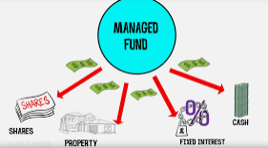
Some Other Financial Assets
Summary
Money! – used to buy things.
Loans – money that must be paid back
Certificate of Deposit – long term bank account that pays high interest. Managed funds - professionals invest your money for you
Money – cash, bank account funds – no list of financial assets is complete without money! We can use money to buy the things we need!
Loans – borrowing money which must be paid back with interest.
  Just like bonds, it is debt that will be paid back.
  Mortgage
    This is a loan for people to buy a house. It is therefore usually a very long term loan.
Certificates of Deposit – this is similar to you depositing money in the bank but is more long term. It pays a higher interest but you can’t touch the money until the end of the period or you give up the interest.
Money Market Funds
  These are where many individuals give money to professionals who invest it for you. Hopefully they will be able to grow your money.
    Mutual Funds
    Pension / Retirement funds

Slide 6



Cash = Liquid
Cash is the most liquid asset. It is 100% liquid.
We can also say cash has 100% liquidity.
A house is not very liquid because it will take a while to convert to cash.
  You have to put the house up for sale, negotiate with buyers, sign documents and many other things! This process can take weeks or even months before you can finally convert it to cash!
Thought Experiment
Imagine trying to pay for a taxi with a piece of your house! This isn’t possible and so you would need to convert your house to cash first before being able to buy goods/services.
Activity
Put these items in order of liquidity.
Shares, your retirement fund, your Wechatpay balance, US dollars in China, your laptop, a candy bar
Answer:
Wechat pay, US dollars, Laptop, Candy Bar, Shares, Retirement Fund
(1) Prison Economy | National Geographic - YouTube

Slide 7
More on Bonds

Slide 8

2nd Hand Market for Existing Bonds
Original amount
Eg. $1000
A big difference between bonds and loans is that bonds can be sold before they expire/reach maturity.
The repayments now go to the new bond holder.
Often the government
This price of the second hand bond will be lower than the original amount for the new bond because bond has been partly paid off)
Eg. $500
Pays back the face value $1000 + regular interest payments
Original Bond buyer / Lender

Slide 9


Interest Rate Effect on Bond Price Example
Let’s say we have a 5 year bond where the original amount was $1000 and the interest rate is 5%.
High Market Interest Rates eg. 10%
Now our bond and it’s coupon rate will not appear that great because there are other options that pay higher interest. So people will be less willing to buy this bond and so the bond price falls.
Low Market Interest Rates eg. 1%
Now our bond will pay higher interest than other assets and will appear amazing compared to the 1% interest rate. People will be willing to pay a higher price for the bond.
Summary
2nd hand bonds will be more attractive if they pay a higher interest rate than the market interest rate.
And vice versa.
↓Price of the bond
↑Price of the bond

Slide 10
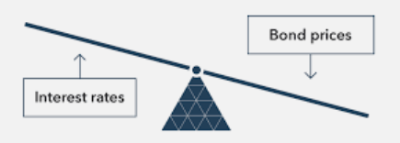
The Price of Bonds
Note: Loans tend to be more strongly linked to one borrower and one lender, and therefore can’t be sold on the open market.
Bonds can be bought and sold on the open market.
Bonds have a lifetime until the debt of the bond has been repaid – called reaching maturity. When all the money and interest is repaid, the life of the bond ends – it reaches maturity.
However, before the bond reaches maturity, the owner of the bond can sell their bond to someone else (just like you can sell a 2nd hand phone or bike before it dies/breaks completely).
(2nd hand bond)
How the Interest Rate Affects Bond Price
The price of the bond being sold is determined by the current market interest rate.
  If the interest rate is higher than the bond’s interest rate doesn’t seem as attractive. Therefore the bond’s price will be lower.
  If the interest rate is lower than the bond’s interest rate is more attractive. Therefore the bond’s price is higher.
(market interest rates eg. For NEW bonds)
Summary
Bonds can be resold on the open market before they are completely paid off.
High interest – bond price lower
Low interest – bond price higher

Slide 11
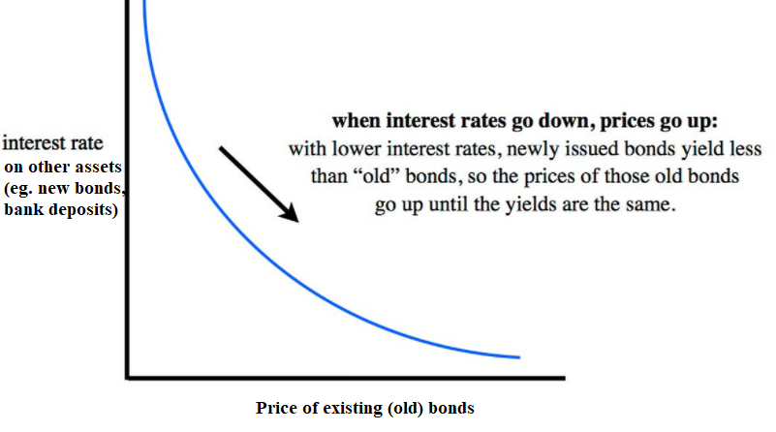
Graphical Relationship between Bond Prices and Market Interest Rates

Slide 12

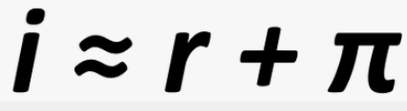
The Fisher Effect and Interest
A famous economist called Robert Fisher proposed the Fisher Effect, represented by the equation: Real Interest = Nominal Interest - Inflation.
We know that interest is the cost of borrowing money / the reward for lending money.
Example
A bank lends $100,000 to a couple to buy a house and they must pay back the $100,000 plus an additional amount called interest. 3% interest per year would mean the couple must pay back an extra $3000 in interest each year (as well as part of the original sum).
How Banks Approach Inflation
When a bank lends, they try to consider the inflation level, using the Fisher Equation.
When inflation changes from the expected level, this can cause the real rate to be higher or lower than expected.
This can benefit the bank (inflation is lower than expected) or benefit the borrower (inflation is higher than expected)
Because Inflation decreases the value of money, interest payments are worth less.
Therefore, Real Interest = Nominal Interest – Inflation
or Nominal Interest = Real Interest + Inflation
This relationship was identified by the economist Robert Fisher and is therefore called the Fisher Effect.
Eg. The bank charges 5% interest for its mortgages and the inflation rate is 2%. The real interest rate is 5-2=3%.
Summary
Nominal interest = the number cost of borrowing
Real interest = the true cost of borrowing
Real interest = nominal interest – inflation
This is called the Fisher Effect after Robert Fisher.
Consequences of Inflation Home
i = nominal interest
r = real interest
Π = inflation

Slide 13




Unexpected Inflation vs Unexpected Deflation
Unexpected Inflation
The actual inflation rate is higher than expected.
Therefore the Real Interest Rate is lower than expected.
Lender loses, borrower gains.
Unexpected Deflation
The actual inflation is lower than expected.
Therefore the RIR is higher than expected.
Lender gains, borrower loses.
Summary
Unexpected Inflation – benefits borrower.
Unexpected deflation – benefits lender.

Slide 14
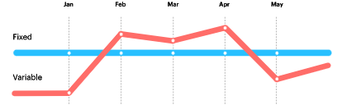
Fixed vs Variable Interest Rates
Summary
Fixed interest rate – NIR doesn't change if inflation changes -> there are winners and losers.
Variable Interest Rate – NIR will change if inflation changes -> no winners and losers
When someone borrows money from a bank, the contract could have either a fixed or variable interest rate.
  Fixed = doesn’t change
  Variable = does change
Variable can mean many things, but typically means it will change with inflation.
  If ↑Inflation→↑NIR, ↓Inflation→ ↓NIR
  Because the NIR varies, the RIR will be constant
    Therefore there will be no winners or losers when the interest rate is variable.
However, with fixed interest rate there can be winners and losers because the NIR will change.
However almost all questions in AP Macro will concern fixed interest rates. In the real world, variable interest rates are very common and they will vary based on different factors.

Slide 15
Inflation
Level 1:
Inflation benefits borrowers
Deflation benefits lenders
Level 2:
Unexpected inflation benefits borrowers
Unexpected deflation benefits lenders
Level 3:
Fixed Nominal Interest Rate
  Unexpected inflation benefits borrowers
  Unexpected deflation benefits lenders
Variable Nominal Interest Rate
  Nobody benefits or loses when inflation changes
Actually not completely true.
Largely true, but we need to consider one more thing…

Slide 16




Opportunity Cost of Holding Liquid Money
Opportunity Cost
Recall that opportunity cost is the cost that comes from any decision that we make because we give up the next best option.
Liquid money is convenient, it does not pay us interest (or extremely low interest) when we hold it to use.
  Usually the less liquid the money, the higher the interest rate.
We assume that the next best thing we can do with our money is to invest it in financial assets such as bonds or long term bank accounts. It is less convenient but it will pay us interest.
Therefore, this is the opportunity cost of liquid money – the interest we could have earned from other financial assets.
Option 1:
Keep cash or keep money in your Wechat pay account with 0% interest and use it to buy various things.
Option 2:
Keep money in an interest bearing account or buying a financial asset which pays 3% interest per year.
Opportunity Cost of Option 1 is the benefits of Option 2 ie. The 3% interest.
Summary
Holding money has an opportunity cost of the interest you could have earned by buying an interest bearing asset.

Slide 17



Roles of Money
Summary
Money has 3 main roles.
Medium of Exchange – used to buy goods and services
Store of Value – we can hold money and spend it in the future.
Unit of Account – we can measure the value of things using money.
Definition of Money
Anything that can be used as a medium of exchange.
Barter
Without money we would be forced to barter for goods and services.
Eg. I want some apples so I trade you for some rice.
However, this creates problems when you don’t want rice!
Money eliminates this problem because everyone accepts money.
Certain things can be used as payment such as gift cards but are not universally accepted and so are called ‘near monies’.
Note: Inflation will cause both unit of account and store of value roles of money to no longer be as effective.

Slide 18

Fiat Money, Commodity Money, Commodity Backed Money
Historical Context: The Rystones of Yap Island
On an island in the Pacific Ocean, the currency are huge stones called Rystones. Because they are so large, and therefore difficult to make, they are hard to counterfeit and this makes it a trusted currency.
Commodity money – money is made out of gold, silver, copper etc.
  In prisons, cigarettes and even packets of fish have been used as money.
Commodity backed money – a certain amount of money can be exchanged for a certain amount of commodity. Eg. $100 = 1 gram of gold
  Slightly more efficient than commodity money because fewer resources are needed in storage
Fiat money – ‘paper money’ – this money is not linked to any real element. Therefore a government can increase or decrease the amount money as much as they want.
Bonus: Cryptocurrency – this is digital money that decentralized (not produced by any national governments). The most well known currencies are Bitcoin and Ethereum.
A Yap Island Ry Stone.
(1) Prison Economy | National Geographic - YouTube
Crash Course – examples of money

Slide 19
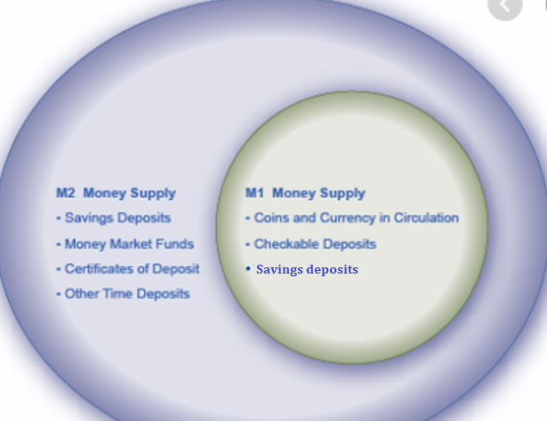

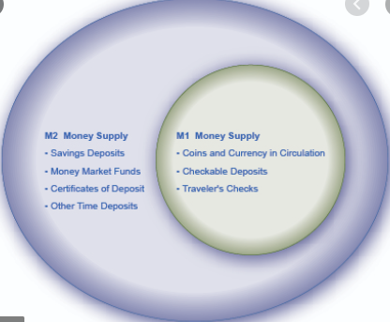

M1 and M2 Money
      Note: One clue is to ask what the interest rate is. If the interest rate is higher, then the money is less liquid and therefore more likely to be examples of other types of money in M2.
Summary
M1 – liquid money
M2 – includes M1 + less liquid money
M1 money
  Highly liquid
    Cash, demand deposits, checkable deposits, savings deposits
M2 money
  Broader definition of Money
  Includes M1 + less liquid money
    Certificates of deposit, Term Deposits, Money Market Funds
  These are often called ‘near monies’ because they can’t be immediately used as money but are easily converted to money
Not Included:
Gift cards, municipal bonds (lower level gov bonds), gov bonds
Savings deposits
The main difference between M1 and M2:
M1 is more liquid and is easily used in transactions than M2.
M2 must be converted to M1 before it can be used for spending.
M2 INCLUDES M1 money.
  “Remember that 2 is bigger than 1.”

Slide 20
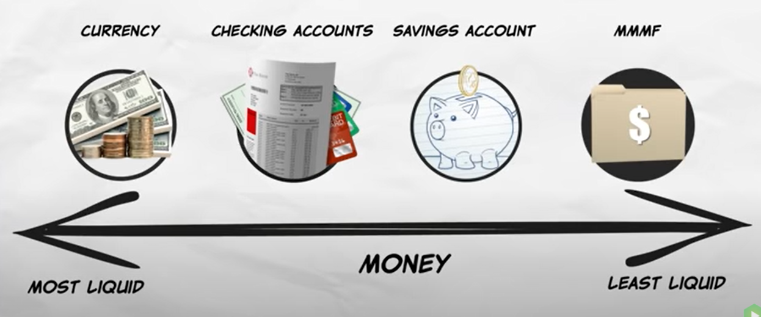
M1 or M2?
Money Market Mutual Funds
M1 (and M2)
M1 (and M2)
M1 (but not as liquid as checking accounts) (and M2)
M2 only

Slide 21
M1 = more liquid forms of money
Liquid
Illiquid
M2 (includes M1 but also less liquid monies)

Slide 22

Types of Bank Accounts
Summary
M1 bank accounts – can be assessed directly without permission.
M2 only bank accounts – can’t be assessed directly without permission.
We can divide bank accounts into those that are counted in M1 and those that are counted in M2 but not M1. This is determined by how accessible/liquid they are.
Can Pay for things without the need to ask for permission
These bank accounts which can be used for direct purchases are typically referred to as:
  Checking Accounts
  Demand Deposit Accounts
  Demand Deposits
  Checkable Deposits
  Savings Accounts
These are the accounts directly connected to your Wechat Pay and Alipay accounts
Must ask permission from someone to be able to use this money
Typically you will have to transfer to your demand deposit account/checking account before you can use for purchases.
These accounts can be referred to as:
  Term Deposits
  Certificates of Deposit
They will typically pay a higher interest rate because the money is less accessible.
M1 (and M2)
More accessible/liquid
Note: Credit Unions essentially function the same way as banks but are non-profit, and are sometimes referred to in questions.
M2 only
Less accessible/liquid

Slide 23
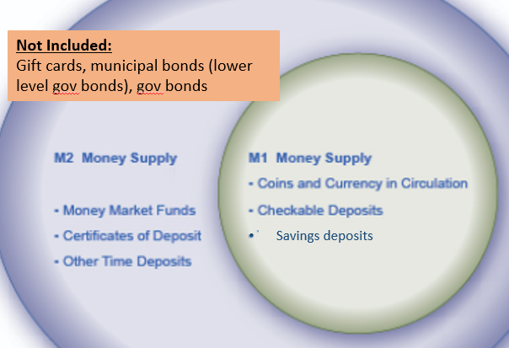
Unit 4 Progress Summary
Real Interest = Nominal Interest – Inflation
Nominal Interest = Real Interest + Inflation
Actual Inflation = Expected + Unexpected
Financial Assets
Bonds – debt asset. Pays interest to owner of the bond
Stocks – equity/ownership asset. Pays share of profit called dividends.
Certificates of Deposit – depositing money in a bank for a longer period which cannot be touched or the interest is not paid.
Mutual Funds – money given to professionals who invest it for you. Eg. Retirement Fund
Unexpected inflation benefits borrowers when there are fixed interest rates.
Unexpected deflation benefits lenders when there are fixed interest rates.
Medium of Exchange – used to buy goods and services
Store of Value – we can hold money and spend it in the future.
Unit of Account – we can measure the value of things using money.
Opportunity Cost of Money
Holding money has an opportunity cost of the interest you could have earned by putting in a savings account/investing.
Relationship of (second hand) bond price to interest rate.
Types of Money
Commodity Money – eg. money made of gold
Commodity backed – money can be used to claim gold/silver
Fiat – money that has no backing and can be increased without limit by the government.
Higher Interest Rate makes second hand bonds less attractive.

Slide 24
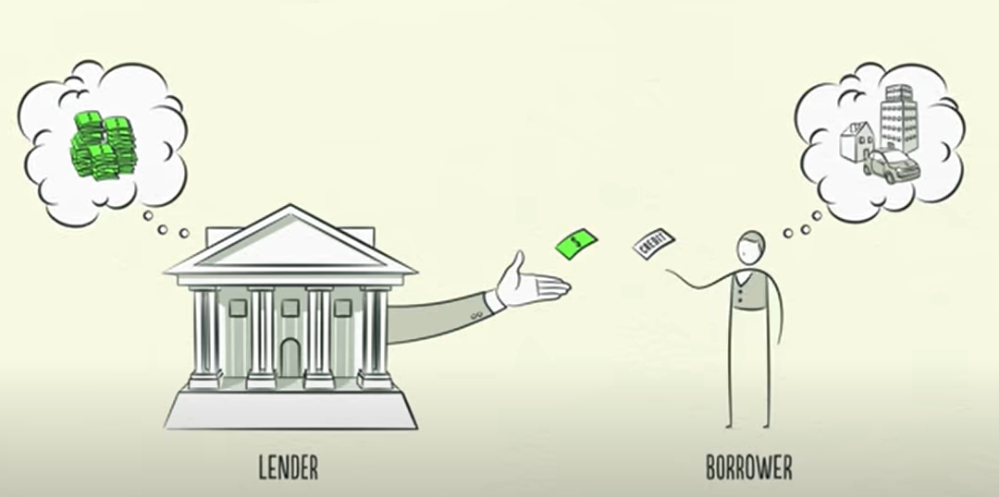

The Financial System
Summary
The main function of the financial system is to act as an intermediary between those with surplus money borrowers who can use the money for various purposes.
The financial system serves to take money from people who have saved and lend it to those who want to borrow.
This results in higher economic efficiency because resources are being allocated to the highest value users.
Related Terms:
Providing credit (lender’s perspective)
Taking on debt (borrower’s perspective)
Loans, also called ‘providing credit’
Savings
Pay back Loan
+ Interest
Interest
Note: The interest that the bank charges borrowers is higher than the interest it pays for your savings. That is how the bank makes money!

Slide 25


Benefits of a Financial System
By acting as this intermediary, they benefit society by:
  Reducing Transaction Costs
    People who save don’t have to worry about expending time and effort finding someone to lend to
    People who borrow don’t have to expend time and energy asking hundreds or thousands of different people
  Reducing Risk – diversification
    When you save money in a bank, you are essentially lending your money to thousands of different people because this is what the bank does with your money.
    This has less risk because it is much less likely that a thousand people won’t pay you back
  Providing Liquidity
    Liquid money is needed by businesses and individuals to purchase goods and services which boosts the economy. Banks make it far easier for people to access liquid money on short notice.
“Don’t put all your eggs in one basket.”

Slide 26
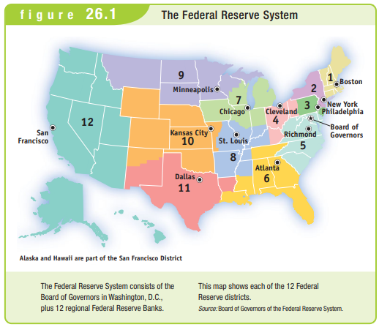
The Federal Reserve
The Federal Reserve is the name of the US Central Banking Authority / Reserve Bank, often referred to as ‘The Fed’
The Fed performs several roles:
  Provide financial services – the ‘banker’s bank’
  Supervise banking system – ensure that rules and regulations are followed to ensure the overall health of the financial system
  Conduct Monetary Policy – this is the main topic of Unit 4 which we will cover in more detail.
Summary
The central bank in the US is called the Federal Reserve aka. The Fed
It serves to manage the financial system and conduct monetary policy.

Slide 27

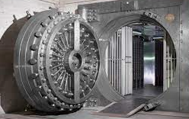


Required Reserves
Your Deposits
Summary
Required reserves = must be kept
RRR = required reserve ratio (percentage that must be kept)
Excess Reserves – up to the bank if they want to keep them
Required Reserves is the amount that banks are required by law (set by the Federal Reserve) to keep in reserve.
  This prevents banks from lending out too much of the deposits, so that if customers wish to withdraw money they have enough.
  This money is actually kept in the Reserve Bank’s vaults (nowadays increasingly electronic in nature)
The bank can choose to keep excess reserves if they choose. This is not mandatory.
Total Reserves
Free to be lent out etc.
The Fed ensures enough reserves are kept. The required reserves are actually stored in the Fed’s own vaults.
Required Reserves
Excess Reserves
Bank can choose to keep these
The Fed

Slide 28
Required Reserves and the Required Reserve Ratio
The required reserve ratio (RRR) is the percentage of total deposits that the bank must hold in reserve.
Total Reserves
Eg. A bank has $10 million in deposits and keeps $2 million in reserve
Required Reserve Ratio (RRR)
= Required Reserves / Total Deposits x 100%
Example: $1 million required reserves, $10 million total deposits, RRR = $1 million / $10 million x 100 = 10%
Required Reserves
Set by the Federal Reserve and is mandatory for all banks to follow.
Excess Reserves
Up to the discretion of the individual bank
$1 million
The bank may be cautious and not want to buy assets or loan out an additional amount.
Summary
Required Reserves – mandatory, set by the RRR
Excess Reserves – extra reserves that the bank may choose to keep
RRR = Required Reserves / Total Deposits x 100%
Eg. RRR = 10% and $10 million deposits. Therefore, $1 million

Slide 29
Summary - Reserves
Total Reserves = Required Reserves + Excess Reserves
  Required Reserves - banks must keep this amount and this will be kept in the Federal Reserve vaults.
  Excess Reserves – these are kept above the required reserves. It is the money that is most available for the bank to use.
Required Reserve Ratio (RRR) = Required Reserves / Deposits

Slide 30
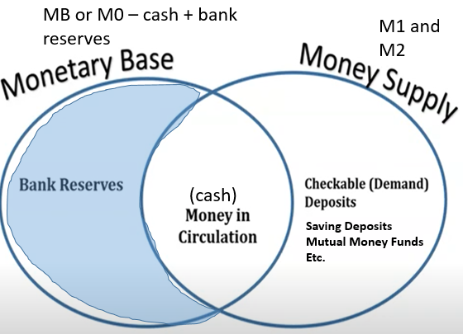
Monetary Base vs Money Supply
Monetary Base (M0 or MB)
Includes currency in circulation and bank reserves
Reserves held in Fed Vault
Reserves held in individual banks
Money Supply (MS)
M1 and M2
  Currency in circulation (M1)
  Demand deposits (M1)
  Traveller's Checks (M1)
  Time Deposits (M2)
  CDs (certificates of deposit) (M2)

Slide 31
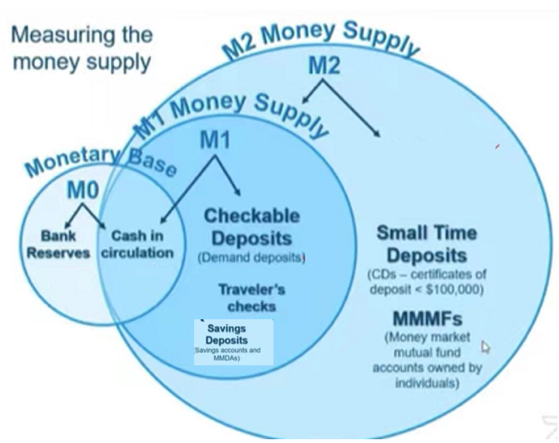
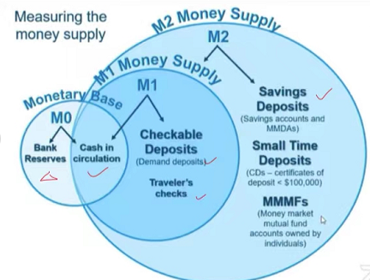




Money Aggregates Summary
Note: You may see higher aggregates of money such as M3 and even M4. The Fed stopped releasing reports on the M3 money supply in 2006 stating that it did not contain useful additional information.
M0 or MB is the monetary base
M1 is liquid money
M2 includes M1 but also less liquid forms of money
Narrow
Money
Broad
Money
Note: The above terms are sometimes used to describe M1 vs M2 money.

Slide 32
Assets, Liabilities (and Bonus: Equity)
Understanding the assets, liabilities and equity will help us with the next topics; T Accounts and the Money Mulitplier

Slide 33



  Unit 5 – Financial Information and Decisions
  Chapter 22 – Balance Sheets
Assets: resources that are owned by a business or owed to the business.
Liabilities: debts of the business that will have to be paid sometime in the future.
Equity: difference between assets and liabilities. It represents the total value/ownership of the business.
Banks as well as businesses can classify what they have in three categories.
Bonus: The records of these assets, liabilities and equity are recorded in a Statement of financial Position, also often called a Balance Sheet

Slide 34


Liabilities
Assets
Liabilities represent things that will lead to negative money flow in the future, and are mostly things that are owed (eg. money borrowed that you must pay back)
Assets are:
Things that will bring money in the future or are owned (eg. you lend money and it will be paid back)
Things that can be sold for money (eg. equipment)
Actual money (eg. cash in a bank account)
Summary
Assets – things that will give money in the future
Liabilities – things that will take away money in the future.
Assets, Liabilities, Equity

Slide 35




Equity
Assets, Liabilities, Equity
-
Equity = Assets – Liabilities
When you take the assets (good things in the business) minus liabilities (bad things in the business), what is left over is the equity.
The bigger the equity, the better. This means the business has far more good things (assets) than bad things (liabilities).
=
Liabilities
Assets
Equity
Note: When you buy a share in a company, you are said to own a piece of the equity of the business. It is therefore sometimes called Shareholder’s Equity – the value of the business from the owner’s perspective.
Summary
Equity = assets – liabilities
The value of the company.
When you buy a stock/share it means you are a part owner of the equity of the company.

Slide 36
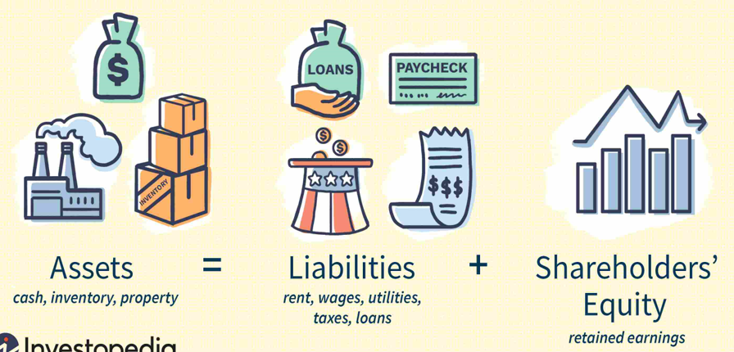
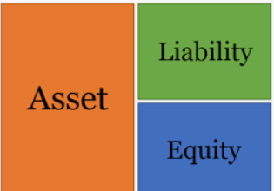
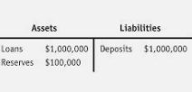
Note: It doesn’t matter if the assets are on the left or right of the T Account.
These are all different ways of representing the assets, liabilities and equity of a company.

Slide 37

T Accounts
Summary
The T account has assets on one side and liabilities on the other.
Assets – things that will give money in the future
Liabilities – things that will take away money in the future.
We have established that businesses have: Assets = Liabilities + Equity
And that the accounting equation can be represented in a ‘T Account’ which details the two sides of the equation.
  Assets on one side
  Liabilities (and equity) on the other
Note: Because AP Macro is not an accounting course, we will rarely if ever, have equity on our T accounts. If we did it would be on the side of Liabilities (because of the accounting equation).
Because of this, in AP Macro we can really think of the accounting equation as: Assets = Liabilities
Liabilities
Liabilities represent things that will lead to negative money flow in the future, and are mostly things that are owed (eg. money borrowed that you must pay back)
Assets
Assets are:
Things that will bring money in the future or are owned (eg. you lend money and it will be paid back)
Things that can be sold for money (eg. equipment)
Actual money (eg. cash in a bank account)

Slide 38
Bank Assets and Liabilities
Summary
Any amount of money is simultaneously an asset and a liability. This is why the two sides are balanced.
Example
A customer deposits $6000 in a bank, and the bank then uses that money in a few different ways.
Asset because when you keep reserves with the Federal Reserve, this money is owed to you. Note: the RRR is 25% in this case.
Liability because it is money owed to the customers because they can withdraw at any time.
Asset because when you buy a bond then money is owed to you.
Note: Even though there is $6000 dollars shown on each side, does not mean there is $12000. The same $6000 is both an asset AND liability.
It just shows how the $6000 is viewed/used by the bank.
Asset because when you lend money to somone then money is owed to you.

Slide 39

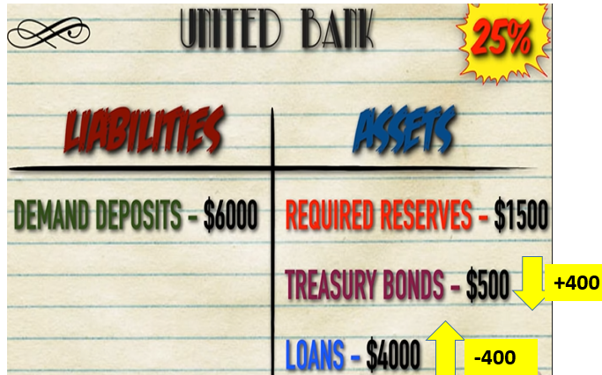
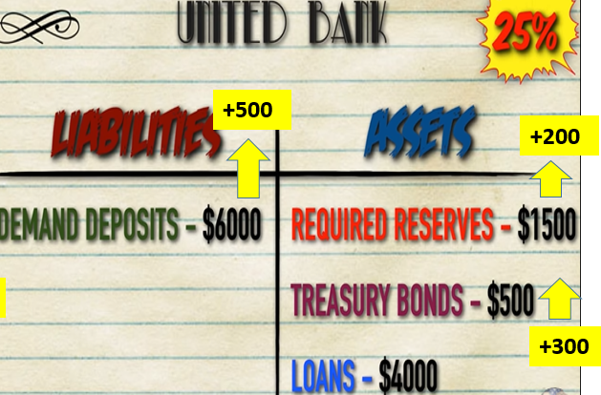
T Accounts Summary
Liabilities | Assets
Deposits | Required Reserves Excess Reserves Bonds Securities (securities is a generic word for a financial asset) Loans
We assume that banks have: assets and liabilities
Assets – things that have money value or can earn money in the future
  Loans – people will have to pay you back
  Required Reserves – the Fed will have to pay you back
  Excess Reserves – this is liquid money that the bank is just holding!
  Bonds – you will be paid back
Liabilities – things that will cost money in the future
  Deposits – this is money that the you must pay back to the customers
Assets = Liabilities (+Equity)
  Therefore both sides must be balanced.
Two sides are always balanced.
Therefore any change has to maintain the balance.
Affects 1 side of the T Account
Affects both sides of the T Account

Slide 40
‘Change in Deposits’ – T Account Questions

Slide 41

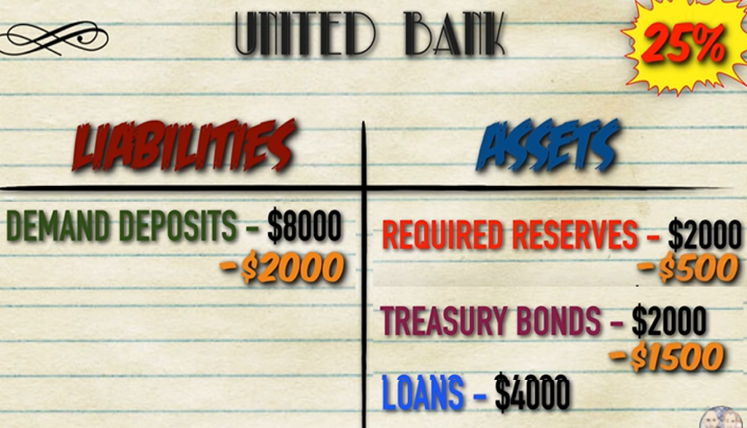
Example – decreasing deposits
A customer takes out $2000 of the money they deposited in the bank.
Original Balances
Changes have to be balanced on both sides after a decrease in Deposits of -$2000
Required Reserves:
  Demand deposits_{new} = 6000
  Required Reserves_{new} = 6000 x 0.25 = 1500
  Therefore Change = -$500
Treasury Bonds – this comes next because we don’t have any excess reserves and loans will be last.
  We have enough to cover the rest of the change
  Therefore Change = $-1500
Final Balances
Change of Liabilities/Assets
When we decrease liabilities side the money comes out of the assets in order:
Required reserves first.
Excess Reserves
Other assets (eg. Bonds)
Loans last
OR the bank can BORROW FROM OTHER BANKS

Slide 42
T Accounts Summary
Liabilities | Assets
Deposits | Required Reserves Excess Reserves Bonds Securities (securities is a generic word for a financial asset) Loans
We assume that banks have: assets and liabilities
Assets – things that have money value or can earn money in the future
  Loans – people will have to pay you back
  Required Reserves – the Fed will have to pay you back
  Excess Reserves – this is liquid money that the bank is just holding!
  Bonds – you will be paid back
Liabilities – things that will cost money in the future
  Deposits – this is money that the you must pay back to the customers
Assets = Liabilities (+Equity)
  Therefore both sides must be balanced.
Two sides are always balanced.
Therefore any change has to maintain the balance.
Affects 1 side of the T Account
Affects both sides of the T Account
Change of Liabilities/Assets
When we decrease liabilities side the money comes out of the assets in order:
Required reserves first.
Excess Reserves
Other assets (eg. Bonds)
Loans last
OR the bank can BORROW FROM OTHER BANKS

Slide 43
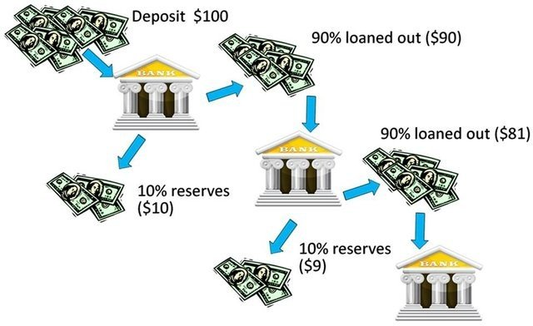
The Fractional Reserve Banking System
As we will soon see, the fact that banks keep a fraction of reserves and are able to loan out the rest is significant to the supply of money in the economy.
It is also the reason why we often refer to the US banking system as a Fractional Reserve Banking System.
Bank Reserves
Total Reserves = Required Reserves + Excess Reserves
Reserve Ratio = Total Reserves / Deposits
Required Reserve Ratio = Required Reserves / Deposits
Summary
Banks keep a fraction of reserves which is why the system is called a fractional reserve banking system.

Slide 44
The Money Multiplier
In Unit 3 we covered the Spending Multiplier (=1/(1-MPC) which showed how spending increased total expenditure through the economy by more than the original spending.
In Unit 4 we will look at the Money Multiplier, which is mathematically similar. However the Money Multiplier shows instead how the supply of money is increased in the economy by the banks.

Slide 45


Money Multiplier
Unit 3
  We covered the Spending Multiplier (=1/(1-MPC) which showed how spending increased spending through the economy.
Unit 4
  We have established in Unit 4 that banks operate under the fractional reserve banking system in which reserves must be kept but the rest can be lent out.
  We will now look at the Money Multiplier, which is mathematically similar. However the Money Multiplier shows how the supply of money is increased in the economy by banking system.
Summary
The money multiplier is the way that banks can increase the money supply.
We will see they do it by lending!

Slide 46
How the Money Multiplier Works
Summary
The money multiplier is the result of the fact that banks can lend and lend and lend.
The money multiplier is linked to the Required Reserve Ratio because it determines how much can be lent out as loans.
$100
Example
Let’s assume the Required Reserve Ratio is 10%. You deposit $100 in a bank.
Bank A:
When you deposit $100 in a bank, Bank A, the bank has to keep 10% as reserves = $10. The bank is then free to lend $90 out as loans.
Bank B:
If this money is lent to another bank, Bank B, they will have to keep 10% of this $90 = $9. But they can lend out the remaining $81.
Bank C:
If this money is lent to another bank, Bank C, they will have to keep 10% of this $81 = $8.1. But they can lend out the remaining $72.9.
Bank D:
If this money is lent to another bank, Bank D, they will have to keep 10% of this $72.9 = $7.29. But they can lend out the remaining $65.61.
Etc.
$90
$81
$72.9
$65.6
Etc.

Slide 47
How the Money Multiplier Works
Summary
The Money Multiplier is a limit given by 1/RRR
The money multiplier is linked to the Required Reserve Ratio.
Example
Let’s assume the Required Reserve Ratio is 10%. You deposit $100 in a bank.
Bank A:
When you deposit $100 in a bank, Bank A, the bank has to keep 10% as reserves = $10. The bank is then free to lend $90 out as loans.
Bank B:
If this money is lent to another bank, Bank B, they will have to keep 10% of this $90 = $9. But they can lend out the remaining $81.
Bank C:
If this money is lent to another bank, Bank C, they will have to keep 10% of this $81 = $8.1. But they can lend out the remaining $72.9.
Bank D:
If this money is lent to another bank, Bank D, they will have to keep 10% of this $72.9 = $7.29. But they can lend out the remaining $65.61.
Etc.
So the total amount of money created is
90 + 81 + 72.9 + 65.61 + … etc.
This is (just like the spending multiplier from Unit 2) a limit which is given by a formula.
The formula for this limit is given by:
∆First Loan x 1/RRR
= 90 x 1/0.1 = 900
For proof of this, possibly ask Mr Bram!

Slide 48
Excess Reserves = Possible Additional Loans
We have covered excess reserves, which is money that banks keep ‘just in case’ above what they are required to keep by the Federal Reserve.
Because this is extra money not being used, this can be easily used to create new loans.
In many questions, it will ask ‘what is the amount this bank can increase its loans’.
  You should look at the excess loans. This is the amount that can be loaned out.
Excess Reserves
Loans
Summary
Excess reserves is extra cash and so this can be immediately turned into new loans.

Slide 49
Same Numbers but Different Question
$50 million with a RRR of 0.2
Normal Money Supply Questions
Usually when customer deposits money in bank
Buying/Selling Bond questions
Happens when the government buys/sells bonds
Deposit Questions
Calculate the ∆ deposits in the bank system instead of the ∆ money supply
Reserves Questions
Calculate the ∆ reserves in the bank system instead of the ∆ money supply
∆MS = ∆Initial x Money Multiplier
Initial = 50 x (1-0.2) = 40
∆MS = 40 x 1/0.2 = 200
∆MS = ∆Initial x Money Multiplier
Initial = 50 because when gov buys bonds it uses money not in the MS
∆MS = 50 x 1/0.2 = 250
∆deposits = ∆Initial deposit x Money Multiplier
Initial = 50
∆Deposits = 50 x 1/0.2 = 250
∆reservces = ∆Initial reserve x Money Multiplier
Initial = 50 x 0.2 = 10
∆Reserves = 10 x 1/0.2 = 100

Slide 50
Maximum Money Supply Created vs Actual
When we use the money multiplier formula we are calculating the maximum possible increase in money supply.
However, several things could make the money supplier smaller than the maximum.
  Consumers may hold extra cash – won’t have as many deposits to lend out
  Banks keep excess reserves – banks will therefore not lend out the full amount possible
  Low Demand for Loans – if no one wishes to borrow money then banks won’t be able to make loans
Maximum money supply change
Banks keep no excess reserves
Customers hold no extra cash
Complete demand for loans so banks have no extra money left over
Below Maximum money supply change
Initial Change in Money Supply
Banks keep excess reserves
Customers hold cash
Low demand for loans
Money Multiplier
1/RRR
Summary
The maximum money supply increase will likely be less because not all possible money will be loaned out for various reasons.

Slide 51
Money Multiplier Summary
The maximum effect of the money multiplier will be less if:
  Consumers may hold extra cash – won’t have as many deposits to lend out
  Banks keep excess reserves – banks will therefore not lend out the full amount possible
  Low Demand for Loans – if no one wishes to borrow money then banks won’t be able to make loans
Reserves
Total Reserves = Required Reserves + Excess Reserves
Excess Reserves can be directly turned into loans. Many questions will assume you know this.
Required Reserves = Deposits x RRR
RRR = Required Reserve Ratio = Required Reserves / Deposits
Money Multiplier = 1/RRR
  This occurs because banks can lend to other banks which can lend the money again and again etc.
∆MS/Deposits/Reserves = First Change x Money Multiplier
= First Change x 1/RRR
You will have to work out logically how the ∆Loans will affect the money supply or amount of deposits if the question asks.

Slide 52

Buying Bonds vs Selling Bonds
Summary
The Fed buying bonds will increase the monetary base first, then the money supply when banks start to loan.
Money that the Fed holds is not a part of the money supply.
So when the Fed buys they put new money in the money supply and when they sell they take money out of the money supply.
The Fed Buys Bonds
The Fed Sells Bonds
M1 & M2 Money Supply
M1 & M2 Money Supply
Bonds
Bonds
Bonds leave the system and money enters the money supply.
Therefore money supply increases.
Buy = Big
Bonds enter the system and money leaves the money supply.
Therefore money supply decreases.
Sell = Small
Note: The Monetary Base (MB) the first thing to increase when the Fed buys bonds. Once banks start lending, money supply will then increase.

Slide 53
Buying Bonds – Increase Monetary Base THEN Money Supply Afterwards
Summary
Money from the Fed goes into excess reserves first (monetary base) and then once the banks start lending it enters the money supply.
When the Fed buys bonds from the banks, the money supply will increase, however it occurs in a particular order.
  1. The money that the Fed uses to buy bonds will first go into the excess reserves of banks.
  Because reserves are not part of the money supply, only the monetary base increases at first.
  2. However, once the banks start to lend, the money supply will also increase.
M1 & M2 Money Supply
Monetary Base
Gov buys bonds
Reserves
Banks start lending to each other

Slide 54
3 Types of Question – Money Multipliers
Money is already in the MS – Normal Question
Eg. You deposit $100 in a bank and the RRR = 0.1
  ∆MS = ∆Loans(maximum) = Loan_{original} x Money Multiplier
  = 90 x 1/0.1 = 900
Smaller Number
Money is NOT already in the MS
Eg. The central bank buys $100 of bonds from you and then you deposit in the bank.
  ∆MS = Money for bond + ∆Loans(maximum) = Loan_{original} x Money Multiplier
  = 100 + 90 x 1/0.1 = 1000 (also = 100 x 1/0.1 = 1000)
Bigger Number
Change of Deposits in Banking System
Eg. You deposit $100 in the bank. Total Effect on Deposits?
  ∆Bank Deposits (maximum) = Initial Deposit + ∆Loans(maximum)
  = Initial Deposit + Loan_{original} x Money Multiplier = 100 + 90x1/0.1 = 100 + 900 = $1000
  = Initial Deposit x Money Multiplier
  = 100 x 1/0.1 = $1000

Slide 55
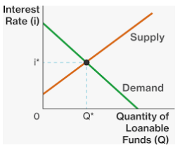
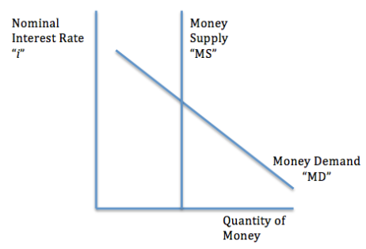
Two types of money market.
Money Market
Shows how people demand cash and liquid money (M1) to be used primarily for transactions
Loanable Funds Market
Shows how people want to lend/borrow money for long term investments

Slide 56
Money Market / Liquidity Preference Model

Slide 57
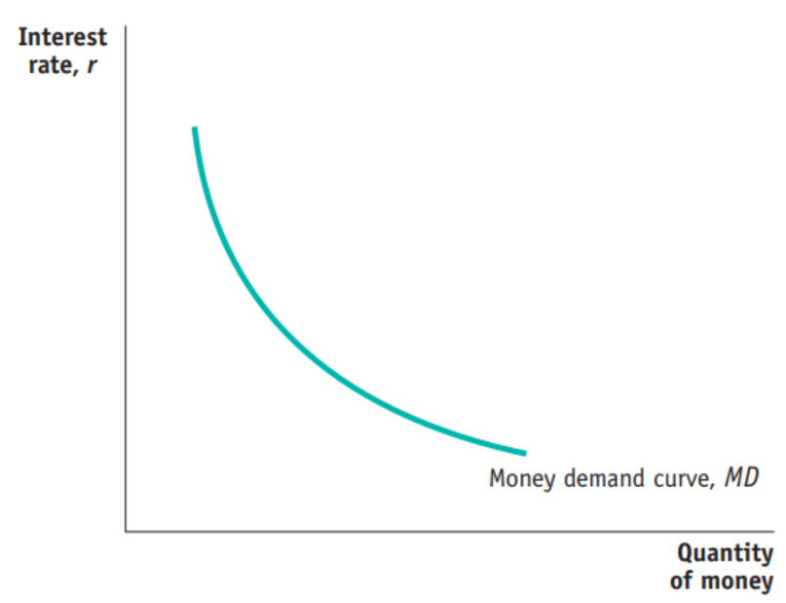
Money Market / Liquidity Preference Model
Money demand / Liquidity preference refers to the choice of holding money versus saving it elsewhere. (Liquidity = cash, eg. converting a house to cash by selling)
Note: This money is M1, liquid money.
Reasons to hold money
  transactions (consumption)
  As an asset
  Precaution
Remember: The cost of holding money is the nominal interest rate, ie. the interest that you give up.
  You do not receive interest when you hold cash or keep money in checking accounts.
  (Interest is also the reward for not holding liquid money.)
These are high value users; people who want to hold liquid money even if they give up a lot of interest.
Nominal
6%
As the interest rate falls, the Cost of holding liquid money falls because people aren’t giving up as much interest.
More people will hold liquid money.
1%
Summary
The demand for liquid money is for transactions and to hold as an asset.
There is a negative relationship between interest rate and money held.
(M1)

Slide 58





Reasons to Hold Money
Summary
M1 money is held for 3 reasons: Transactions, as an Asset, as a precaution.
The need for M1 money in transactions means that demand for money is linked to Aggregate Demand.
Transactions
This is self explanatory. Liquid money is needed to buy things.
This includes all expenditure within the economy, namely
  C, I, G, X-M
  Therefore, holding M1 money is very much linked to Aggregate Demand!
Asset
Money, like any asset can go up or down in value.
Some investors speculate on the prices of various currencies. They can earn profit if they can correctly predict whether the value of an asset goes up or down.
  Example: Buy 100 USD for 680RMB, then later sell $100 USD for 720RMB. In this case you have made 40RMB profit!)

Slide 59


Reasons to Hold Money continued…
Precaution
This is a relatively minor category, however many people store small amounts of cash for certain emergency situations.
Eg. Many people keep some extra money in their wallet.
Many people keep extra money in their house in a safe place.

Slide 60
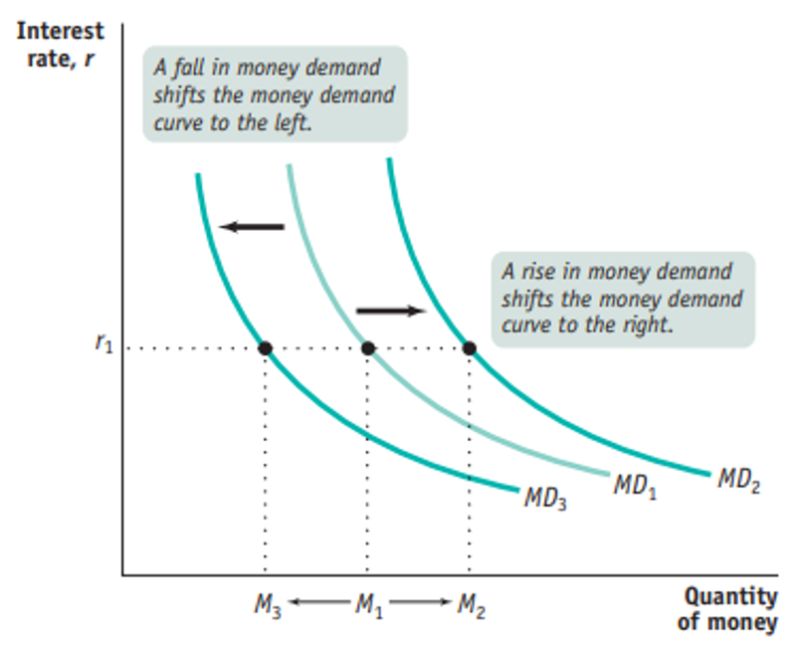
Shifters of Money Demand
Summary
Changes in price level, national income, technology or anything that changes AD will shift the MD curve.
The price level - When inflation occurs, people start demanding more money because the cost of living increases. As a result, the MD curve shifts to the right.
The national income level - An increase in the real GDP results in higher incomes. Consequently, people start demanding more money since their wealth increases.
Changes in technology – people can hold less liquid money because of online banking, so that money is converted to M1 money just as they make the purchase.
Important Note: Change in interest rate will move us up and down the same MD curve.
Increase in AD effect on MD
In order to buy goods and services liquid money is required. Therefore anything that will increase or decrease AD will also increase or decrease MD.

Slide 61
Money Demand Shifters
Factor | Increase | Decrease
Wealth | ↑MD (wealthier people spend more) | ↓MD
Income | ↑MD (higher income people spend more) | ↓MD
AD Aggregate Demand | ↑MD (more spending means people need more liquid money) | ↓MD
Price Level | ↑MD (more spending means people need more liquid money) | ↓MD
Banking System Convenience | ↓MD (people need to hold less liquid money) | ↑MD

Slide 62
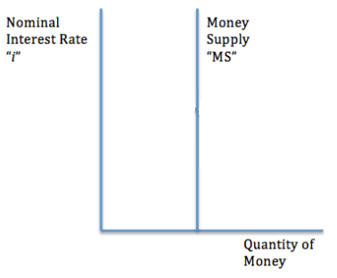
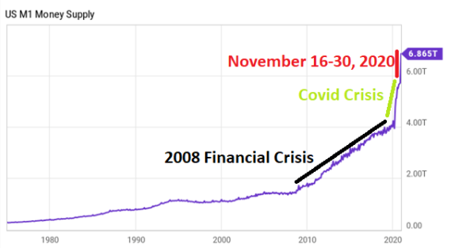
Money Market Supply
Summary
The money supply, MS is vertical because it is set by the Federal Reserve. The Fed will increase or decrease the money supply in different situations.
The money supply, MS, is set by the Federal Reserve through their various policies and how much money is printed.
The MS determines how much money people have access to.
Because the Federal Reserve is a non-profit organization, it will not seek additional profit when the interest rate is higher.
  Therefore we can assume that the supply curve, money supply curve, MS, is vertical.
Shifts of MS
Because the MS is controlled by the Fed, any increase or decrease in MS is also made by the Fed.
The Fed can choose to increase or decrease the money supply depending on the state of the economy.
Real World Money Supply Changes
In recent years the money supply has increased multiple times in response to recession type events.

Slide 63
Money Supply Shifters
Factor | Increase | Decrease
Required Reserve Ratio | ↓MS | ↑MS
Discount Rate | ↓MS | ↑MS
Buying Bonds | ↑MS | ↓MS
Selling Bonds | ↓MS | ↑MS
Note: Only central bank policy will shift money supply.

Slide 64
Money Market Equilibrium
Summary
The money market shows demand and supply of liquid money.
Nominal interest is used because it is short term and has no expectations of inflation.
The MD and MS results in an equilibrium where MD = MS
Because the MS is vertical, the quantity of money will always be at the same level determined by the MS.
Nominal Interest Rate
However, the nominal interest rate ‘i’ will vary.
The reason that we use nominal interest for the Money Market is that it is based in the short run and there are no expectations about future change of price level ie. Inflation. Because we are not concerned with inflation, we are looking at the nominal interest rate.

Slide 65
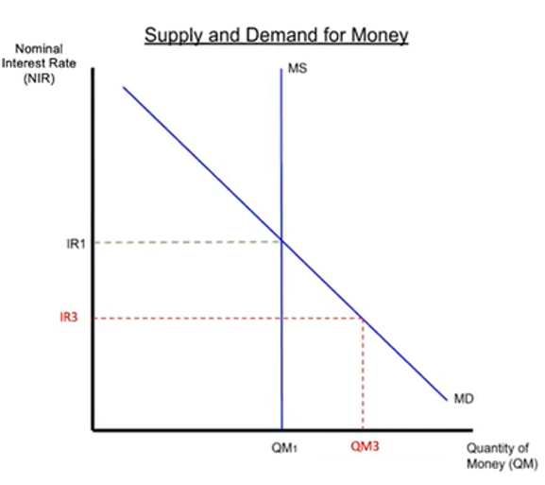
Market Adjustment – Surplus and Shortage
Summary
The market will naturally return to equilibrium where Qd=Qs.
Interest rate too high -> surplus -> IR will fall.
Interest rate too low -> shortage -> IR will increase.
Just like with all demand and supply, the market will return an equilibrium where Qd = Qs.
At higher interest rates, there will be a surplus of M1 money (Qs > Qd) Eventually lenders will decide to lower the interest rate and equilibrium will be restored.
At lower interest rates, there will be a shortage (Qd > Qs) which eventually will lead to a higher interest rate.

Slide 66
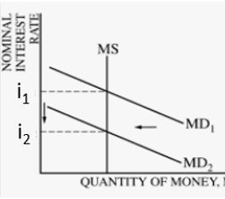
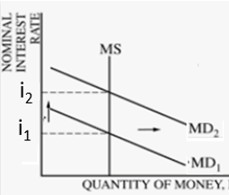
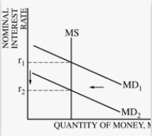
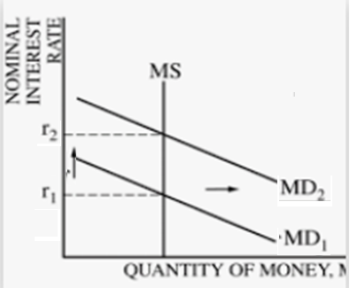
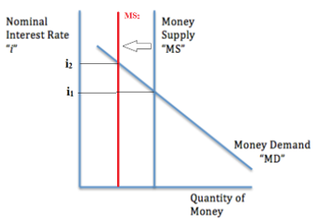
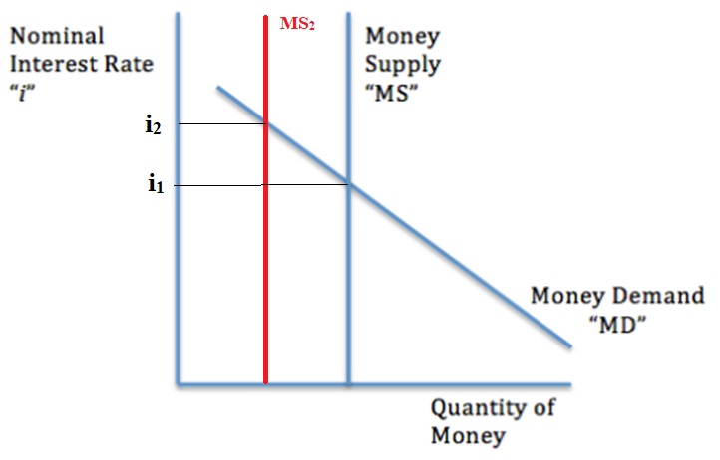
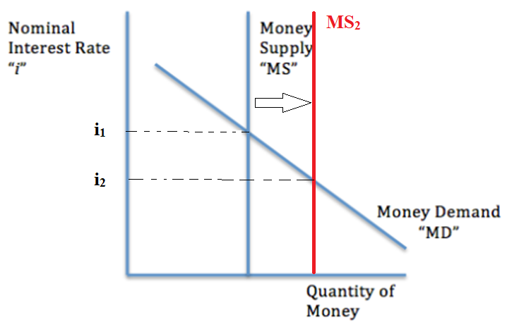
Change in Equilibrium
Equilibrium will change if either MD or MS changes.
Change in MD
  Only affects the interest rate but not the quantity of money because of the vertical MS.
Change in the MS
  Affects both the quantity of money and the nominal interest rate.
↓ MD→↓nominal interest
↑MD →↑ nominal interest
The change in nominal interest rate has significant consequences for the rest of the economy!
Hint: We briefly looked at monetary policy in previous classes. We will see how this
Summary
Changes in MD or MS will change the equilibrium.
There will be:
change in Nominal interest
and/or
change in Quantity of Money held
↓ MS→ ↑ nominal interest,
↓Quantity of Money
↑ MS→↓nominal interest,
↑ Quantity of Money

Slide 67
The Money Market and Monetary Policy

Slide 68
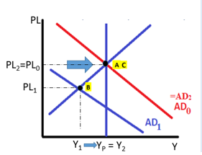
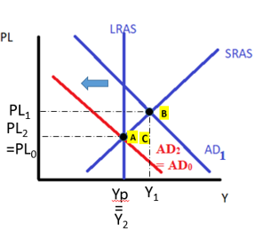
How the Money Market is Connected to Monetary Policy
Monetary policy is often conducted by changing the money supply which then changes the interest rate.
We will see how this occurs.
Summary
Monetary policy is often done by increasing or decreasing the money supply! This affects the interest rate which then affects AD.
Increase MS
An increase in MS, will decrease the nominal interest rate.
This lowers the cost of borrowing money, which will increase C and I in the economy. This will increase AD.
↑MS→ ↓Nominal Interest Rates
→ ↓Cost of Borrowing
→ ↑Consumption↑ Investment
→ ↑ Aggregate Demand
Decrease MS
A decrease in MS will increase the nominal interest rate
↓MS→↑Nominal Interest Rates
→↑Cost of Borrowing
→↓Consumption↓Investment
→↓Aggregate Demand
Expansionary Monetary Policy
Contractionary Monetary Policy

Slide 69
In many cases:
Monetary Policy = Changing the Money Supply -> changing the interest rate

Slide 70
Money Market Summary
Contractionary Monetary Policy
↓ Money Supply, ↑ Interest Rates
↓C↓I
Money Demand (MD)
  The demand to hold liquid money.
    Reasons: Transactions, to hold as an asset
  ↑Interest Rate↓Quantity of Money demanded (negative relationship)
  Shifters: ∆Price Level, ∆National Income, ∆ Bank Technology, ∆AD
Money Supply (MS)
  The supply of money which is controlled by the Federal Reserve which is why it is vertical.
  Shifters: Increases or decreases in MS are made by the Fed
Nominal Interest Rate is used in this model
  The Money Market is a ‘short term’ market and inflation is not a factor in the short run.
Expansionary Monetary Policy
↑Money Supply, ↓Interest Rates
↑C ↑I

Slide 71
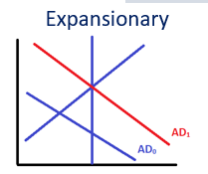
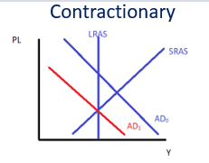
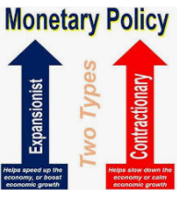
Monetary Policy Review
Monetary policy is the other main tool that the government can use to manage the economy. (What was the other one? Fiscal Policy)
Monetary Policy - Changing Money Supply
We have now seen that MP is the changing of the interest rate by changing the money supply.
Changing the interest rate has the following consequence on the economy.
  Investment (I) changes because the cost of borrowing is lower
  Consumption (C) changes for interest sensitive products such as houses, cars, college tuition etc.
  This leads to an increase or decrease in AD which can help fight a slowing economy which is in a negative output gap.
Fighting Recession / Correcting -ve output Gap
↑ money supply →↓ interest rate → ↑ AD
Note: The effect on the AD is the same as fiscal policy.
Fighting Inflation / Correcting +ve output Gap
Summary
Monetary Policy – ↑↓ money supply to ↓↑ the interest rate.
Expansionary – ↑ AD (correct –ve output gap)
Contractionary – ↓ AD (correct +ve output gap)
↓ money supply → ↑ interest rate → ↓ AD

Slide 72

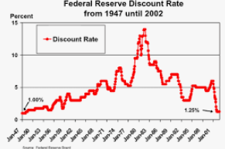

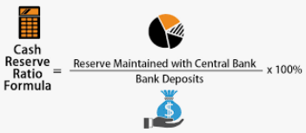
Three Tools of Monetary Policy
How does the government and Fed actually affect implement their policy?
Three Tools of Monetary Policy
Open Market Operations (OMO)
  Buy bonds = increase the money supply -> decrease the interest rate
  Sell Bonds = decrease the money supply -> increase interest rate
  Remember: Buy Bonds = Big (increase money supply), Sell Bonds = Small (decrease money supply)
3. Discount Rate and Federal Funds Rate
  Increase Discount Rate or Federal Funds Rate – decrease the money supply -> increase interest rate
  Decrease Discount Rate or Federal Funds Rate – increase the money supply -> decrease interest rate
2. Required Reserve Ratio (RRR)
  Increase RRR – decrease the money supply -> increase interest rate
  Decrease RRR – increase the money supply -> decrease the interest rate
Required
Securities = bonds
(or any other financial assets)

Slide 73
Monetary Policy Tools Summary
↓ Money Supply, ↑ Interest Rates
Contractionary Monetary Policy
Contractionary Monetary Policy Tools
Open Market Operations (OMO) – Sell bonds → money leaves money supply →
↑ Required Reserve Ratio → Less money available for borrowing/lending →
↑Discount Rate or Federal Funds Rate→ ↑ Cost of borrowing → ↓Bank borrowing/lending →
↓C↓I
Expansionary Monetary Policy
↑C ↑I
Expansionary Monetary Policy Tools
OMO – Buy Bonds → new money enters money supply →
↓Required Reserve Ratio→ More money available for borrowing/lending →
↓Discount Rate or Federal Funds Rate→ ↓Cost of borrowing → ↑ Bank borrowing/lending →
↑Money Supply, ↓Interest Rates

Slide 74
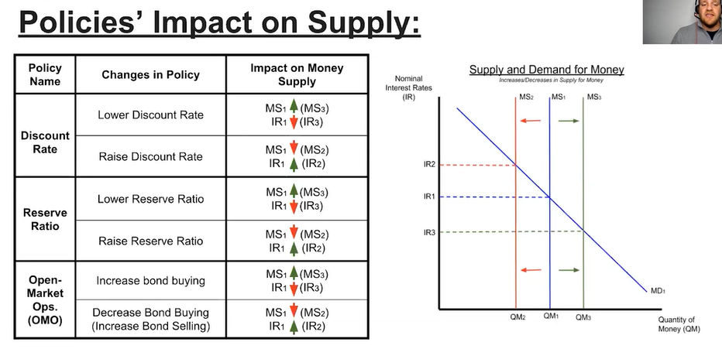

Alternate Monetary Policy Tools Summary

Slide 75
Limited Reserves vs Ample Reserves
We will soon see that the three tools of monetary policy that we have covered apply when the economy has limited reserves.
In an ample reserves economy, different policy actions must be taken.

Slide 76
Three Tools of Changing Money Supply for Monetary Policy
How does the government and Fed actually affect implement their policy?
Three Tools of Monetary Policy
Open Market Operations (OMO)
  Buy bonds = increase the money supply -> decrease the interest rate
  Sell Bonds = decrease the money supply -> increase interest rate
  Remember: Buy Bonds = Big (increase money supply), Sell Bonds = Small (decrease money supply)
3. Discount Rate
  Increase Discount Rate – decrease the money supply -> increase interest rate
  Decrease Discount Rate – increase the money supply -> decrease interest rate
2. Required Reserve Ratio (RRR)
  Increase RRR – decrease the money supply -> increase interest rate
  Decrease RRR – increase the money supply -> decrease the interest rate
Only applies in a limited reserves economy.
Required
Securities = bonds
(or any other financial assets)

Slide 77


Limited Reserve Economy vs Ample Reserve Economy
Limited Reserves (∆MS still affects the IR)
All of our study of money supply and the effect on the interest rate so far applies in a situation where an economy has relatively scarce reserves ie. limited reserves.
  In a situation with limited reserves, there will be a relationship between the supply of reserves and the interest rate, because banks will have more reserves to lend out and can lower their interest rates.
Definition: Ample = enough, sufficient
Ample Reserves (∆MS has no effect on IR anymore)
When an economy has so called ample reserves, this changes the nature of the monetary policy.
  After a certain point, more reserves don’t make a difference to the interest rate.
  Therefore, the Fed must act differently to try and control the interest rate.
Summary
Limited reserves economy – 3 tools of MP can be used (OMO,
Ample reserves economy – other tools must be used

Slide 78
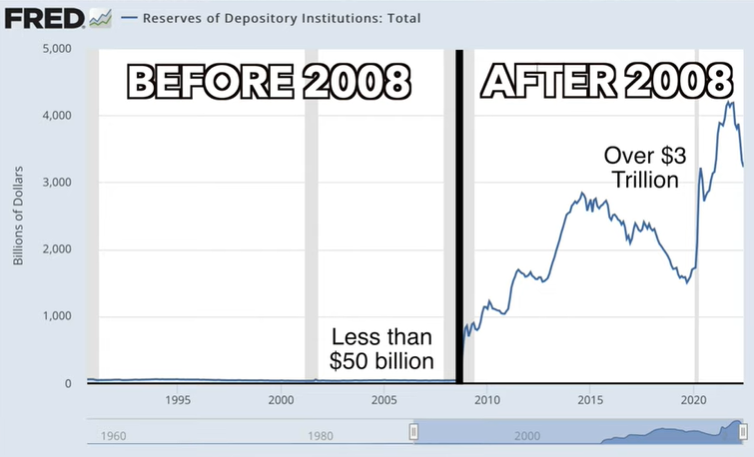

Slide 79
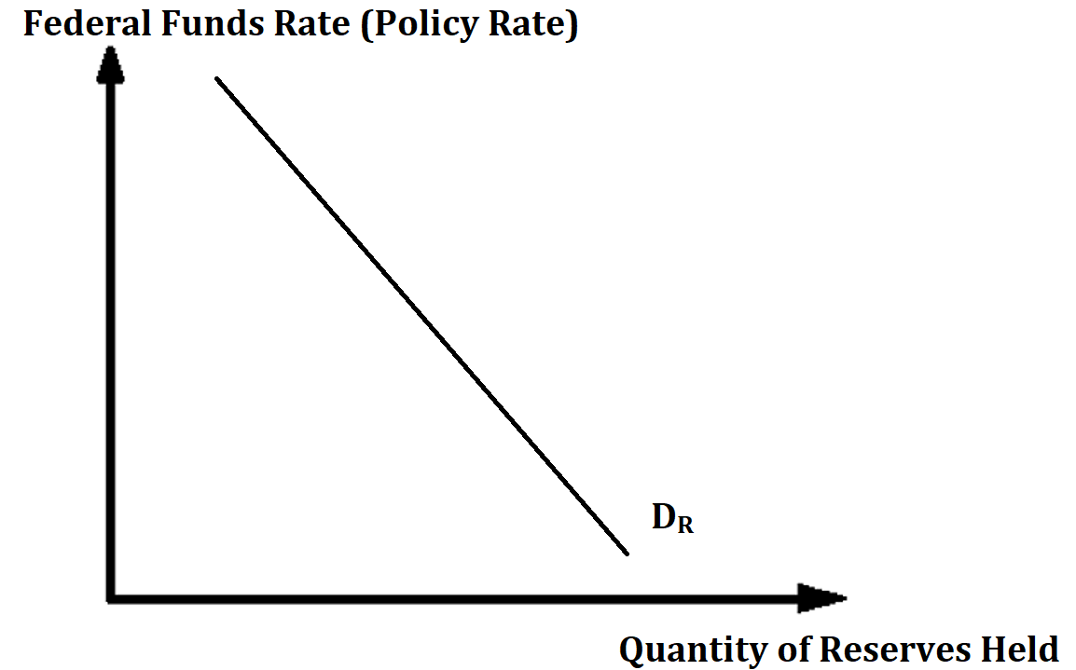
Demand of Reserves
When the federal funds rate is high, banks would prefer to hold less reserves, because they can lend their money out instead.
When the federal funds rate is low, banks will be more willing to hold reserves, because they are not giving up as much interest on what they could earn.
Therefore the relationship between reserves and federal funds rate (the cost of holding reserves) is negative (which is true for all demand curves).

Slide 80
Different Interest Rates Summary
Administered Interest Rates
Policy Rate (PR)
Discount Rate (DR)
Banks pay to the Fed for loans
Interest on Reserves (IOR)
The Fed pays to banks for reserves
Federal Funds Rate (FFR)
Bank to bank

Slide 81
Relationship between Administered Interest Rates and Policy Rate
Administered Interest Rates
Interest on Reserves
Discount Rate
Policy Rate
= market interest rate
= federal funds rate
Used to try and influence

Slide 82
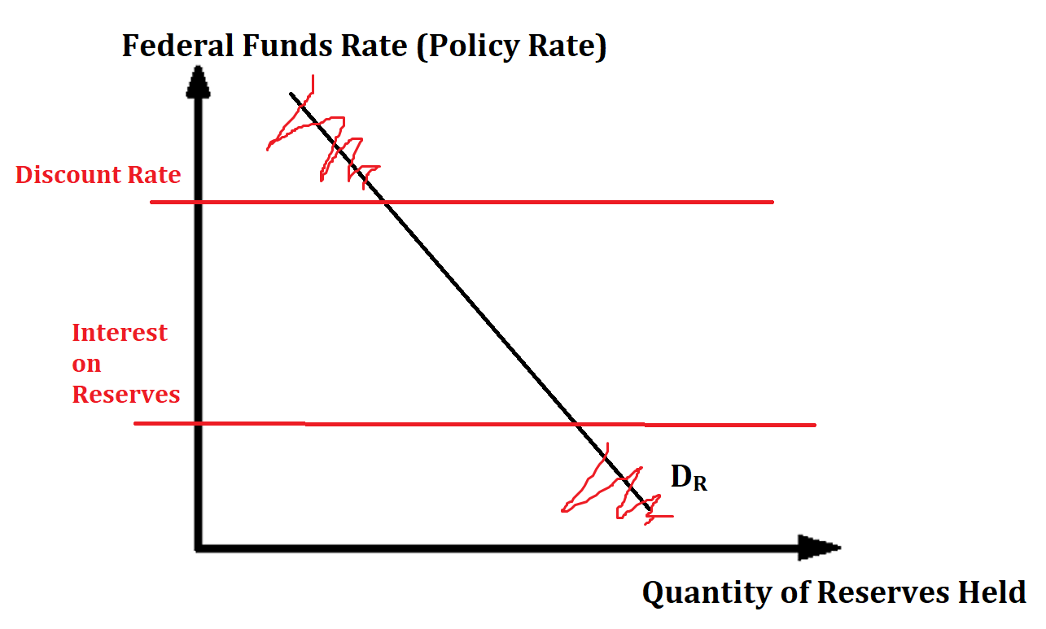

Administered Interest Rates and Reserve Demand
The Discount Rate and IOR has an effect on the shape of the D_{R} curve.

Slide 83

Explaining the Strange Shape of Demand for Reserves
We assume the supply of reserves is controlled by the Fed and is therefore vertical.
The demand curve for reserves has two horizontal parts.
A: Discount Rate – if the federal funds rate is higher than the discount rate, commercial banks will not lend to each other and therefore not demand any reserves, because they can borrow from the Fed instead for cheaper. So banks won’t bother
B: Interest on Reserves (IOR) Banks will want to hold as many reserves as possible if the federal funds rate is lower than the IOR because they can earn higher interest this way.
Discount Rate
Interest on Reserves

Slide 84
Why the Discount Rate Creates a Horizontal Shape
Example:
Discount Rate = 6%
Federal Funds Rate = 7%
Banks can choose between borrowing for 7% interest from other banks or 6% from the Fed.
Any commercial bank will choose to borrow from the Fed instead.
Therefore, the interest rate effectively cannot go above 6%.

Slide 85
Why the Interest on Reserves Creates a Horizontal Shape
Example:
Interest on Reserves = 2%
Federal Funds Rate = 1%
Banks can choose between making 2% from the Fed by keeping reserves or earning 1% by lending to other commercial banks.
  Therefore, the interest rate effectively cannot go below 2%.
= IOR₁

Slide 86
Equilibrium of Reserves
Summary
Demand of reserves – how much banks want to hold reserves that they can use to lend money and make profit.
Supply of reserves – set by the Fed and therefore vertical.
Demand of Reserves – banks wish to hold reserves for two reasons
  For the purpose of covering their costs
  Banks want reserves to earn interest from the Fed (who will pay the ‘Interest on Reserves’ rate)
Supply of Reserves – set by the Fed and therefore vertical
Equilibrium where Q_{D} = Q_{S}
  The interest rate at this level is the equilibrium Policy Rate (PR), also known as the Federal Funds Rate.

Slide 87
Demand for Reserves Shifters
Factor | Increase | Decrease
Discount Rate | ↑Upper Bound of DR | ↓Upper Bound of DR
Interest on Reserves (IoR) | ↑Lower Bound of DR | ↓Lower Bound of DR
Note: We haven’t looked at any factors that will actually shift the curve left and right.

Slide 88
Supply of Reserves Shifters
Factor | Increase | Decrease
Buy Bonds | ↑ Supply Reserves (Right) (more money supply means banks also have more reserves) | ↓Supply Reserves (Left)
Sell Bonds | ↓Supply Reserves (Left) (less money supply means banks also have less reserves) | ↑ Supply Reserves (Right)
Required Reserve Ratio | ↓Supply Reserves (Left) (less money supply means banks also have less reserves) | ↑ Supply Reserves (Right)

Slide 89
Limited Reserve Range vs Ample Reserves Range
Limited Reserves Range
Ample Reserves Range

Slide 90

Limited vs Ample Reserves Equilibrium
Limited Reserves Equilibrium
Ample Reserves Equilibrium
For ample reserve economies we are always in this section.

Slide 91

Changing Administered Interest Rates
This means increasing or decreasing the discount rate and interest on reserves.
In an ample reserves economy, this will directly affect the equilibrium interest rate.
  Therefore, this is a way that the Fed can still perform monetary policy even when the money supply no longer affects the IR (as we saw in the previous section)
Summary
Monetary Policy (in an ample reserves economy) is done by changing the administered interest rates.

Slide 92


v

Slide 93
Quick Summary
Deeply understanding this section is more difficult than understanding the bare minimum to answer the questions.
With an ample reserves economy we have to consider this Reserves Market Graph.
Policy Rate (PR) – in the US, the Federal Funds Rate (FFR), the rate that banks pay when they lend to each other.
Policy Rate
Discount Rate (DR) – rate that commercial banks pay to borrow from the Fed.
Eg. 6%
Administered Interest Rates
Interest on Reserves (IOR) – rate that the Fed pays to banks for keeping reserves.
Eg. 0.5%
Most important thing for you:
The Fed can influence the Policy Rate (FFR):
Expansionary MP – lower the IOR and Discount Rate -> lowers the PR (FFR)
Contractionary MP – increase the IOR and Discount Rate -> increases the PR (FFR)

Slide 94
Most important thing for you:
The Fed can influence the Policy Rate (FFR):
Expansionary MP – lower the IOR and Discount Rate -> lowers the PR (FFR)
Contractionary MP – increase the IOR and Discount Rate -> increases the PR (FFR)
Expansionary MP (lowering IR)
Contractionary MP (increasing IR)

Slide 95
Monetary Policy Tools Summary
Limited Reserves Economy
Change the Money Supply using:
  Open Market Operations (OMO)
  Required Reserve Ratio
  Discount Rate
Ample Reserves Economy
Administered Interest Rates
  Interest on Reserves (IOR)
  Discount Rate
Will effect the market interest rate = federal funds rate = policy rate
Similarities in both cases
In both cases, the goal is still just to affect the interest rate! Therefore, lower IR = expansionary MP, higher IR = contractionary MP.

Slide 96

Monetary Policy Lags
Just like with Fiscal Policy, Monetary Policy also has lags, which causes the policy effect to not be immediate.
  Recognition Lag / Data Lags – takes time to collect and analyze the data necessary to make monetary policy decisions.
  Impact Lag / Implementation Lag – takes time for the economy to adjust and the for the policy to take effect.
So actually, MP doesn’t have as much implementation lag as does Fiscal Policy

Slide 97
Loanable Funds Market

Slide 98

Demand for Loanable Funds
Summary
Demand for loanable funds shows how people want to borrow money (for investment and consumption) at different real interest rates (which is the cost of borrowing).
The demand for loanable funds is determined by businesses and households and governments who wish to borrow money/funds for various reasons.
  Consumers: eg. Loan for a house (mortage)
  Businesses: Loan for investment in equipment, expansion, start a business (business loan)
  Government: Infrastructure spending, Education etc. (bonds)
The cost of borrowing is the interest rate.
  A high interest rate means a higher the cost of borrowing, the lower the quantity of money that people will borrow.
  The lower the interest rate, the lower the cost of borrowing and so a larger quantity of money will be borrowed.
We can notate Demand for Loanable funds as D_{LF}
Real Interest Rate
These are high value users; people who will borrow even if the interest rate is high.
Borrowers won’t have to pay as much interest.
More people will borrow for investment purposes.
D_{LF}
Real Interest Rate
The market for loanable funds is more long term in nature.
Because people who borrow money are concerned about future price levels (because this will affect how much they must pay out), we use the real interest rate.

Slide 99

Shifters of Loanable Funds Demand
Summary
Improved ROI (Return on Investment) will increase demand for loanable funds D_{LF}
The demand for loanable funds curve can also shift left or right.
Anything that changes the behavior of investors, borrowing households and borrowed government spending will change D_{LF}.
  Economic confidence - If the economy is doing well people may be more optimistic about the economy and expect greater returns from their investments. Conversely, low confidence will decrease demand.
  New technology – if technology improves than business investment will yield higher returns.
  Rate of Return on Investment – if there are new opportunities for investment, eg. An increase in the car industry in a country, then this will increase the demand for borrowed money.
  Government Subsidies – subsidies for business investment will naturally increase the rate of return for businesses on top of their existing rate of return.
  Government Budgets – if the government has a budget deficit, they will need to borrow more and if they have a budget surplus they will borrow less.
Note: As always, the y axis variable (in this case the real interest) will move us along the same curve but not shift the entire curve.

Slide 100


Supply for Loanable Funds
Summary
Supply of loanable funds is money that is saved and lent out to earn interest.
Higher interest will mean more money will be saved.
Supply of loanable funds is money that is saved for the purpose of lending and earning interest
The interest rate is the reward for lending money.
  High interest rate = people will save more money = more money for lending
    This is because you will earn more interest and so there is a stronger incentive
  Low interest rate = people will save less money = less money for lending
    This is because you will earn less interest and so there is a weaker incentive to save.
r_{high}
r_{low}
This means that foreigners can provide money to be borrowed.

Slide 101

Shifters of Supply
Note: As always, the y axis variable (in this case the real interest) will move us along the same curve but not shift the entire curve.
Summary
Change in saver behaviour will change the supply of loanable funds D_{LF}
  Supply of Loanable funds can increase (shift right) or decrease (shift left) when certain factors change.
  Anything that affects the behavior of savers will affect the S_{LF.}
  Factors (that will affect saver behavior):
  Change in Real GDP/ Wealth – when consumer wealth increases, people have more money to save.
Performance of other markets - if investors believe they can make more money investing in other assets (stocks, property etc.) then they will save less money and try to get higher returns elsewhere
  Eg. Other foreign loanable funds markets, stock market, commodities market
Change in MPC – consumers for different reasons may see a change in their MPC. This will affect how much they save.
Capital Inflows – this refers to foreigners who lend money and expect to be repaid with interest.

Slide 102

Loanable Funds Equilibrium
Summary
Equilibrium will naturally occur in the market with an equilibrium Real Interest Rate and Q_{LF} demand = Q_{LF} supplied (Borrowed money = Lent money)
What the market graph shows:
Loanable funds means money that is lent out to businesses for investment and households for big purchases.
The market will naturally reach an equilibrium with an equilibrium Real Interest Rate where Q_{LF} demanded = Q_{LF} supplied.
Real Interest Rate
Loanable funds market deals with long term thinking unlike the money market which is short term.
The interest rate is the real interest rate, because we assume that for long term investing, investors (who think long term) take inflation into consideration and are therefore only concerned with the real interest rate (= nominal interest – inflation).
Disequilibrium
If the interest rate that savers give to borrowers is too high, then there will be a surplus of loanable funds.
If the interest rate that savers give to borrowers is too low, there will be a shortage because more people will want to borrow than people want to lend.
In either situation, the real interest rate will change so that the shortage or surplus is corrected.

Slide 103



Change of Equilibrium
The loanable funds market equilibrium can change from changes in demand or supply (or both).
This will lead to a change in the real interest rate and the quantity of loanable funds loaned/borrowed.
Consequences for the Macroeconomy
The equilibrium of funds loaned shows the amount of investment and interest sensitive consumption.
Therefore, an increase will lead to an increase in C and I
↑Quantity of Loanable funds means ↑Investment/Consumption/Government Spending → ↑ AD
↓ Quantity of Loanable funds means ↓Investment/Consumption/Government Spending →↓AD

Slide 104
Market For Loanable Funds Summary
Demand for Loanable Funds (D_{LF})
  Businesses and individuals who want to borrow money.
    Reasons: to invest in projects with a rate of return > interest rate, to buy expensive goods such as cars/houses
  High real interest →↓Quantity Loans Demanded (Negative R’ship)
Supply for Loanable Funds (S_{LF})
  Businesses and individuals who wish to lend money.
    Reasons: to earn interest!
  High real interest →↑Quantity Money Loaned (Positive R’ship)
Real Interest Rate
  Because lending money and borrowing money occurs over a longer period of time, the expectations of inflation are relevant. Therefore we consider the Real Interest (Real Interest = Nominal – Inflation)
Factor | Effect on S_{LF}
Real Interest Rate | ↑→Movement right on the same curve ↓→Movement left on the same curve
Consumer Income | ↑→↑S_{LF} (more money saved) ↓→↓S_{LF}
Performance in other markets (eg. Stock market, property market) | ↑→↓S_{LF} (people will invest in other markets) ↓→↑S_{LF}
Tax on interest earnings | ↑→↓S_{LF} (lenders earn less) ↓→↑S_{LF}
Factor | Effect on D_{LF}
Real Interest Rate | ↑→Movement right on the same curve ↓→Movement left on the same curve
Rate of Return/Rate of Return | ↑→↑D_{LF} (investment is more worthwhile) ↓→↓D_{LF}
Economic Confidence | ↑→↑D_{LF} ↓→↓D_{LF}
Government Budget | Deficit →↑D_{LF} Surplus →↓D_{LF}

Slide 105

Money Market vs Loanable Funds Market
Money Growth and Inflation- Macro Topic 5.3 - YouTube
Liquid Money used for all purposes
Borrowing and Lending of Money
Shows the amount of AD = C + I + G + (X-M)
MD Shifters: Price Level, National Wealth, AD
MS Shifters: Federal Reserve Policies
The amount of M1 money
Short term decision making– therefore inflation doesn’t matter, therefore nominal interest rate
Shows the amount of C_{interest sensitive} + I + G_{borrowed}
D_{LF} Shifters: factors that affect investor behaviour
S_{LF} Shifters: factors that affect saver behavior
Shows less liquid money
Long term decision making– therefore inflation matters – therefore real interest rate

Slide 106
Monetary Policy Effect on the Market for Loanable Funds

Slide 107


Expansionary Monetary Policy
Revision: The effects of MP on the rest of the economy:
What happens in the fund when there is expansionary monetary policy in the money markets?
Summary
↑MS→↑C,→↑AD→↑RGDP→↑Wealth→↑Saving→S_{LF}↑
The increase in money held in the money market for transactions means people will spend more, leading to higher incomes and so more money to save, increasing the Supply_{LoanableFunds}.
Note: The reason that spending is connected to incomes is based on the spending multiplier and the concept that ‘one person’s spending is another person’s income’ from Unit 3.

Slide 108


Slide 109


Contractionary Monetary Policy
Revision: The effects of MP on the rest of the economy:
What is the effect on the market for loanable funds when the Central Bank/Fed implements contractionary MP?
Summary
↓MS→↓C→↓ AD→↓RGDP→↓Wealth→↓ Saving→↓S_{LF}
The decrease to money supply for transactions causes less spending, lower incomes and therefore people have less savings, lowering Supply_{LoanableFunds}.
Note: The reason that spending is connected to incomes is based on the spending multiplier and the concept that ‘one person’s spending is another person’s income’ from Unit 3.

Slide 110

Interest Rates are connected
While we have distinguished between the nominal interest rate in the money market, and the real interest rate in the loanable funds market, the two will generally move up and down together (except in the case of inflation where only the real interest will be affected).
So if there is a change in the nominal interest rate in the money market we can also assume there is a change in the market for loanable funds.
Question examples:
  You will notice in some of these questions, even if the IR has increased in the loanable funds market, that the government can reduce the interest rate by increasing money supply in the money market.
Also called liquidity preference model (because it shows how much people demand liquid money)
Summary
Whether in the Money Market or Loanable funds market, we can often treat the interest rate in both as one interest rate.

Slide 111
Government Budgets and National Savings and Debt
Governments use tax to raise revenue and fund government spending and government transfers.
However, the amount of tax and the amount of spending is often not equal.

Slide 112


Government Budget
Summary
Government budgets are the plan for spending and tax and can be balanced, in deficit or in surplus.
The government budget is a plan for the amount of tax and government expenditure.
How does a government pay for Government Spending (G) and government transfers?
  One of the main ways is through raising tax. (Income tax, Consumption tax, Corporate tax, import tax etc.)
National Savings/Public Savings will be affected by the government budget. (Note: Negative Public savings = Public debt)
The government budget is a plan for government expenditure and tax and can fall into three categories:
  Balanced Budget: Tax = Government Expenditure
    National Savings/Debt will stay the same.
  Budget Deficit: Tax < Government Expenditure
    National Savings will decrease/National debt will increase.
  Budget Surplus: Tax > Government Expenditure
    National Savings will increase/National debt will decrease.
The government will have a certain targets for the proportion of spending on different parts of the economy.

Slide 113
National Savings, Public Savings, Private Savings
Private savings = savings from firms and households
Public Savings = Government savings
National Savings = Public Savings + Private Savings
Note: Sometimes National Savings is used to mean Public Savings

Slide 114


Public Debt vs Public Savings
Public Debt = negative amount
  The government has borrowed money overall over a period of time.
  Public debt can also be thought of as ‘negative savings’
Public Savings = positive amount
  The government has saved money overall over a period of time

Slide 115
Government Budgets/Savings/Debt effect on Market for Loanable Funds
Any change to national savings or public savings has an effect on the market for loanable funds.
When we refer to government budgets and government debt/savings, this can affect both the demand and supply of loanable funds.
  Government budget deficit
    Increases borrowing -> increase D_{LF}
    Decreases savings -> decrease S_{LF}
  Government budget surplus
    Decreases borrowing -> decreases D_{LF}
    Increases savings -> increases S_{LF}
Note: Usually the question will give you clues about whether to focus on Demand or Supply.
  Note: without any further information, it is best to assume that it will mainly affect demand
Affects the market for loanable funds
Summary
Government budgets affect the demand and supply for loanable funds, but we usually focus on the effect on demand.
Deficit -> ↑D_{LF} (more borrowing)
Surplus -> ↓D_{LF} (less borrowing)

Slide 116
Budget Summary
 | +/- | Definition | Type of Fiscal Policy | Government Borrowing/Saving | Effect on Loanable Funds Market
Balanced Budget |  | Tax = Government Expenditure | Neutral FP | Borrowing/saving remains the same | D_{LF} unchanged S_{LF} unchanged
Budget Deficit | - | Tax < Government Expenditure | Expansionary FP (↓Tax↑Gov expenditure) | Borrowing increases/ Saving decreases | D_{LF} increases S_{LF} decreases
Budget Surplus | + | Tax > Government Expenditure | Contractionary FP(↑Tax↓Gov expenditure) | Borrowing decreases/savings increases | D_{LF} decreases S_{LF} increases

Slide 117
Unit 4 Progress Summary
Real Interest = Nominal Interest – Inflation
Nominal Interest = Real Interest + Inflation
Actual Inflation = Expected + Unexpected
Financial Assets
Bonds – debt asset. Pays interest to owner of the bond
Stocks – equity/ownership asset. Pays share of profit called dividends.
Certificates of Deposit – depositing money in a bank for a longer period which cannot be touched or the interest is not paid.
Mutual Funds – money given to professionals who invest it for you. Eg. Retirement Fund
Unexpected inflation benefits borrowers when there are fixed interest rates.
Unexpected deflation benefits lenders when there are fixed interest rates.
Money
Definition: can be universally accepted as a medium of exchange.
Liquidity – how easily something can be used to buy things. Cash/easy access digital money is the most liquid asset.
Medium of Exchange – used to buy goods and services
Store of Value – we can hold money and spend it in the future.
Unit of Account – we can measure the value of things using money.
Opportunity Cost of Money
Holding money has an opportunity cost of the interest you could have earned by putting in a savings account/investing.
Types of Money
Commodity Money – eg. money made of gold
Commodity backed – money can be used to claim gold/silver
Fiat – money that has no backing and can be increased without limit by the government.
Relationship of (second hand) bond price to interest rate.
Higher Interest Rate makes second hand bonds less attractive.

Slide 118
Benefits of a Financial System
By acting as this intermediary, they benefit society by:
  Reducing Transaction Costs
    People who save don’t have to worry about expending time and effort finding someone to lend to
    People who borrow don’t have to expend time and energy asking hundreds or thousands of different people
  Reducing Risk – diversification
    When you save money in a bank, you are essentially lending your money to thousands of different people because this is what the bank does with your money.
    This has less risk because it is much less likely that a thousand people won’t pay you back
  Providing Liquidity
    Liquid money is needed by businesses and individuals to purchase goods and services which boosts the economy. Banks make it far easier for people to access liquid money on short notice.
“Don’t put all your eggs in one basket.”

Slide 119
Summary - Reserves
Total Reserves = Required Reserves + Excess Reserves
  Required Reserves - banks must keep this amount and this will be kept in the Federal Reserve vaults.
  Excess Reserves – these are kept above the required reserves. It is the money that is most available for the bank to use.
Required Reserve Ratio (RRR) = Required Reserves / Deposits
Excess reserves is spare money that is not being used by the bank and so this can be immediately turned into new loans.
Excess Reserves
New Loans

Slide 120
Money Aggregates Summary
Note: You may see higher aggregates of money such as M3 and even M4. The Fed stopped releasing reports on the M3 money supply in 2006 stating that it did not contain useful additional information.
M0 or MB is the monetary base
M1 is liquid money
M2 includes M1 but also less liquid forms of money
Narrow
Money
Broad
Money
Note: The above terms are sometimes used to describe M1 vs M2 money.

Slide 121
T Accounts Summary
Liabilities | Assets
Deposits | Required Reserves Excess Reserves Bonds Securities (securities is a generic word for a financial asset) Loans
We assume that banks have: assets and liabilities
Assets – things that have money value or can earn money in the future
  Loans – people will have to pay you back
  Required Reserves – the Fed will have to pay you back
  Excess Reserves – this is liquid money that the bank is just holding!
  Bonds – you will be paid back
Liabilities – things that will cost money in the future
  Deposits – this is money that the you must pay back to the customers
Assets = Liabilities (+Equity)
  Therefore both sides must be balanced.
Two sides are always balanced.
Therefore any change has to maintain the balance.
Affects 1 side of the T Account
Affects both sides of the T Account
Change of Liabilities/Assets
When we decrease liabilities side the money comes out of the assets in order:
Required reserves first.
Excess Reserves
Other assets (eg. Bonds)
Loans last
OR the bank can BORROW FROM OTHER BANKS

Slide 122
How the Money Multiplier Works
Summary
The Money Multiplier (MM) is a limit given by 1/RRR
The total amount of money created = Initial Loan x MM
The money multiplier is linked to the Required Reserve Ratio.
Example
Let’s assume the Required Reserve Ratio is 10%. You deposit $100 in a bank.
Bank A:
When you deposit $100 in a bank, Bank A, the bank has to keep 10% as reserves = $10. The bank is then free to lend $90 out as loans.
Bank B:
If this money is lent to another bank, Bank B, they will have to keep 10% of this $90 = $9. But they can lend out the remaining $81.
Bank C:
If this money is lent to another bank, Bank C, they will have to keep 10% of this $81 = $8.1. But they can lend out the remaining $72.9.
Bank D:
If this money is lent to another bank, Bank D, they will have to keep 10% of this $72.9 = $7.29. But they can lend out the remaining $65.61.
Etc.
So the total amount of money created is
90 + 81 + 72.9 + 65.61 + … etc.
This is (just like the spending multiplier from Unit 3) a limit which is given by a formula.
The formula for this limit is given by:
Money creation =
Initial Loan x 1/RRR
= Initial Loan x MM
= 90 x 1/0.1 = 900

Slide 123
If we add up the total amount of additional loans:
90 + 81 + 72.9 + 65.6 + etc.
We observe a limit.
The formula for this limit = 90 x 1/RRR.
For the exact derivation of the formula you are welcome to ask your math teacher but I do not know how it is derived exactly and it is not covered in the course.
$90
Deposits = $100
RR = $10
ER = $90
$81
Deposits = $90
RR = $9
ER = $81
$72.9
Deposits = $81
RR = $8.1
ER = $72.9
$65.6
Deposits = $72.9
RR = $7.29
ER = $65.5
Money Multiplier
=
1/RRR
Etc.
Deposits = $65

Slide 124
Money Multiplier Summary
The maximum effect of the money multiplier will be less if:
  Consumers may hold extra cash – won’t have as many deposits to lend out
  Banks keep excess reserves – banks will therefore not lend out the full amount possible
  Low Demand for Loans – if no one wishes to borrow money then banks won’t be able to make loans
Reserves
Total Reserves = Required Reserves + Excess Reserves
Excess Reserves can be directly turned into loans. Many questions will assume you know this.
Required Reserves = Deposits x RRR
RRR = Required Reserve Ratio = Required Reserves / Deposits
The money multiplier is used to calculate maximum changes in the money supply and to deposits in the banking system.
Money Multiplier = 1/RRR
  This occurs because banks can lend to other banks which can lend the money again and again etc.
∆MS = ∆Loans(maximum) = Loan_{original} x Money Multiplier
= Loan_{original} x 1/RRR
  ∆Bank Deposits (maximum) = Initial Deposit + ∆Loans
  = Initial Deposit + Initial Loan x Money Multiplier = Initial deposit x Money Multiplier

Slide 125
3 Types of Question – Money Multipliers
Money is already in the MS – Normal Question
Eg. You deposit $100 in a bank and the RRR = 0.1
  ∆MS = ∆Loans(maximum) = Loan_{original} x Money Multiplier
  = 90 x 1/0.1 = 900
“Smaller” Number
Money is NOT already in the MS
Eg. The central bank buys $100 of bonds from you and then you deposit in the bank.
  ∆MS = Money for bond + ∆Loans(maximum)
  = Money for bond + Loan_{original} x Money Multiplier
  = 100 + 90 x 1/0.1 = 1000 (also = 100 x 1/0.1 = 1000)
“Bigger” Number
Change of Deposits in Banking System
Eg. You deposit $100 in the bank. Total Effect on Deposits?
  ∆Bank Deposits (maximum) = Initial Deposit + ∆Loans(maximum)
  = Initial Deposit + Loan_{original} x Money Multiplier = 100 + 90x1/0.1 = 100 + 900 = $1000
  = Initial Deposit x Money Multiplier
  = 100 x 1/0.1 = $1000
“Bigger” Number

Slide 126
Change in Money Market Equilibrium
Equilibrium will change if either MD or MS changes.
Change in MD
  Only affects the interest rate but not the quantity of money because of the vertical MS.
Change in the MS
  Affects both the quantity of money and the nominal interest rate.
↓ MD→↓nominal interest
↑MD →↑ nominal interest
The change in nominal interest rate has significant consequences for the rest of the economy!
Hint: We briefly looked at monetary policy in previous classes. We will see how this
Summary
Changes in MD or MS will change the equilibrium.
There will be:
change in Nominal interest
and/or
change in Quantity of Money held
↓ MS→ ↑ nominal interest,
↓Quantity of Money
↑ MS→↓nominal interest,
↑ Quantity of Money

Slide 127
Money Market Summary
Contractionary Monetary Policy
↓ Money Supply, ↑ Interest Rates
↓C↓I
↓AD
Money Demand (MD)
  The demand to hold liquid money (M1).
    Reasons: Transactions, to hold as an asset
  ↑Interest Rate↓Quantity of Money demanded (negative relationship)
  Shifters: ∆Price Level, ∆National Income, ∆ Bank Technology, ∆AD
Money Supply (MS)
  The supply of money which is controlled by the Federal Reserve which is why it is vertical.
  Shifters: Increases or decreases in MS are made by the Fed
Nominal Interest Rate is used in this model
  The Money Market is a ‘short term’ market and inflation is not a factor in the short run.
Expansionary Monetary Policy
↑Money Supply, ↓Interest Rates
↑C ↑I
↑AD

Slide 128
Three Tools of Changing Money Supply for Monetary Policy
How does the government and Fed actually affect implement their policy?
Three Tools of Monetary Policy
Open Market Operations (OMO)
  Buy bonds = increase the money supply -> decrease the interest rate
  Sell Bonds = decrease the money supply -> increase interest rate
  Remember: Buy Bonds = Big (increase money supply), Sell Bonds = Small (decrease money supply)
3. Discount Rate
  Increase Discount Rate – decrease the money supply -> increase interest rate
  Decrease Discount Rate – increase the money supply -> decrease interest rate
2. Required Reserve Ratio (RRR)
  Increase RRR – decrease the money supply -> increase interest rate
  Decrease RRR – increase the money supply -> decrease the interest rate
Required
Securities = bonds
(or any other financial assets)

Slide 129
Monetary Policy Tools Summary
↓ Money Supply, ↑ Interest Rates
Contractionary Monetary Policy
Contractionary Monetary Policy Tools
Open Market Operations (OMO) – Sell bonds → money leaves money supply →
↑ Required Reserve Ratio → Less money available for borrowing/lending →
↑Discount Rate → ↑ Cost of borrowing → ↓Bank borrowing/lending →
↓C↓I
Expansionary Monetary Policy
↑C ↑I
Expansionary Monetary Policy Tools
OMO – Buy Bonds → new money enters money supply →
↓Required Reserve Ratio→ More money available for borrowing/lending →
↓Discount Rate → ↓Cost of borrowing → ↑ Bank borrowing/lending →
↑Money Supply, ↓Interest Rates

Slide 130
Alternate Monetary Policy Tools Summary

Slide 131
Ample Reserves MP Summary
Deeply understanding this section is more difficult than understanding the bare minimum to answer the questions.
With an ample reserves economy we have to consider this Reserves Market Graph.
Policy Rate (PR) – in the US, the Federal Funds Rate (FFR), the rate that banks pay when they lend to each other.
Policy Rate
Discount Rate (DR) – rate that commercial banks pay to borrow from the Fed.
Eg. 6%
Administered Interest Rates
Interest on Reserves (IOR) – rate that the Fed pays to banks for keeping reserves.
Eg. 0.5%
Most important thing for you:
The Fed can influence the Policy Rate (FFR):
Expansionary MP – lower the IOR and Discount Rate -> lowers the PR (FFR)
Contractionary MP – increase the IOR and Discount Rate -> increases the PR (FFR)

Slide 132
Most important thing for you:
The Fed can influence the Policy Rate (FFR):
Expansionary MP – lower the IOR and Discount Rate -> lowers the PR (FFR)
Contractionary MP – increase the IOR and Discount Rate -> increases the PR (FFR)
Expansionary MP (lowering IR)
Contractionary MP (increasing IR)

Slide 133
Monetary Policy Tools Summary
Limited Reserves Economy
Change the Money Supply using:
  Open Market Operations (OMO)
  Required Reserve Ratio
  Discount Rate
Ample Reserves Economy
Administered Interest Rates
  Interest on Reserves (IOR)
  Discount Rate
Will effect the market interest rate = federal funds rate = policy rate
Similarities in both cases
In both cases, the goal is still just to affect the interest rate! Therefore, lower IR = expansionary MP, higher IR = contractionary MP.

Slide 134
Two types of money market.
Summary
The Loanable Funds Market is all about:
Borrowing & Lending Money
Money Market
Shows how people demand cash and liquid money (M1) to be used primarily for transactions
Loanable Funds Market
Shows how people want to lend/borrow money for long term investments

Slide 135
Market For Loanable Funds Summary
Demand for Loanable Funds (D_{LF})
  Businesses and individuals who want to borrow money.
    Reasons: to invest in projects with a rate of return > interest rate, to buy expensive goods such as cars/houses
  High real interest →↓Quantity Loans Demanded (Negative R’ship)
Supply for Loanable Funds (S_{LF})
  Businesses and individuals who wish to lend money.
    Reasons: to earn interest!
  High real interest →↑Quantity Money Loaned (Positive R’ship)
Real Interest Rate
  Because lending money and borrowing money occurs over a longer period of time, the expectations of inflation are relevant. Therefore we consider the Real Interest (Real Interest = Nominal – Inflation)
Factor | Effect on S_{LF}
Real Interest Rate | ↑→Movement right on the same curve ↓→Movement left on the same curve
Consumer Income | ↑→↑S_{LF} (more money saved) ↓→↓S_{LF}
Performance in other markets (eg. Stock market, property market) | ↑→↓S_{LF} (people will invest in other markets) ↓→↑S_{LF}
Tax on interest earnings | ↑→↓S_{LF} (lenders earn less) ↓→↑S_{LF}
Factor | Effect on D_{LF}
Real Interest Rate | ↑→Movement right on the same curve ↓→Movement left on the same curve
Rate of Return/Rate of Return | ↑→↑D_{LF} (investment is more worthwhile) ↓→↓D_{LF}
Economic Confidence | ↑→↑D_{LF} ↓→↓D_{LF}

Slide 136
Money Market vs Loanable Funds Market
Money Growth and Inflation- Macro Topic 5.3 - YouTube
Liquid Money used for all purposes
Borrowing and Lending of Money
Shows the amount of AD = C + I + G + (X-M)
MD Shifters: Price Level, National Wealth, AD
MS Shifters: Federal Reserve Policies
The amount of M1 money
Short term decision making– therefore inflation doesn’t matter, therefore nominal interest rate
Shows the amount of C_{interest sensitive} + I + G_{borrowed}
D_{LF} Shifters: factors that affect investor behaviour
S_{LF} Shifters: factors that affect saver behavior
Shows less liquid money
Long term decision making– therefore inflation matters – therefore real interest rate

Slide 137
Budget Summary
 | +/- | Definition | Type of Fiscal Policy | Government Borrowing/Saving | Effect on Loanable Funds Market
Balanced Budget |  | Tax = Government Expenditure | Neutral FP | Borrowing/saving remains the same | D_{LF} unchanged S_{LF} unchanged
Budget Deficit | - | Tax < Government Expenditure | Expansionary FP (↓Tax↑Gov expenditure) | Borrowing increases/ Saving decreases | D_{LF} increases S_{LF} decreases
Budget Surplus | + | Tax > Government Expenditure | Contractionary FP(↑Tax↓Gov expenditure) | Borrowing decreases/savings increases | D_{LF} decreases S_{LF} increases

